Slide 1
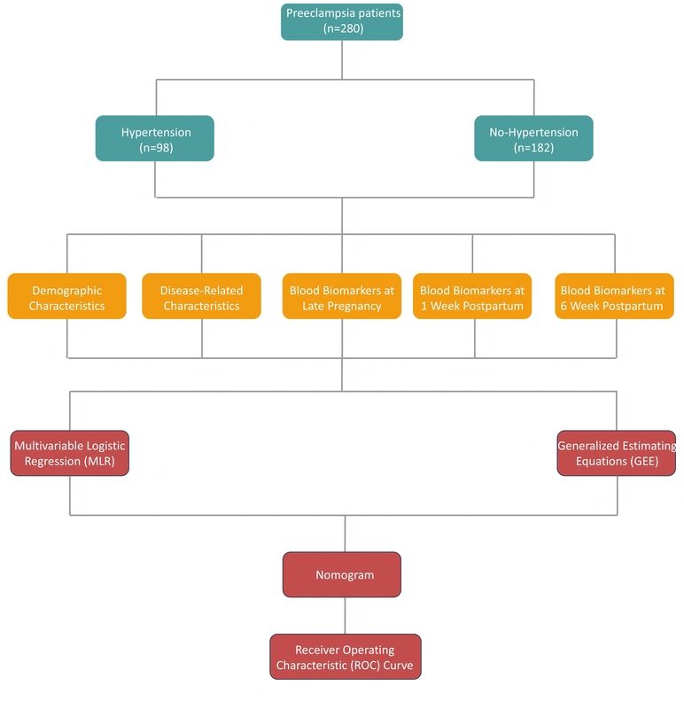

Predicting hypertension in preeclampsia patients within five years postpartum: analysis of influencing factors and nomogram development
DOI: 10.5114/aoms/208999
Arch Med Sci 2026;22(3):1539-1548
Notes:
Introduction
Preeclampsia is a pregnancy-related hypertensive disorder with long-term cardiovascular risks. The aim of this study was to explore the factors influencing hypertension progression in preeclampsia patients within 5 years postpartum, and to construct a nomogram.
Material and methods
A retrospective study of 280 preeclampsia patients, grouped by hypertension progression status within 5 years postpartum, was performed. Differential analyses compared: 1) demographic/pregnancy characteristics, and 2) late-pregnancy, 1-week-postpartum, and 6-week-postpartum blood indicators between groups. Multiple logistic regression and generalized estimating equations (GEE) identified hypertension progression factors. Significant factors used to construct the nomogram were evaluated via calibration and receiver operating characteristic (ROC) curves in training/test sets.
Results
Patients who progressed to hypertension had higher pre-pregnancy and postpartum body mass index (BMI), a greater proportion of early-onset and severe preeclampsia, and a higher incidence of adverse pregnancy outcomes compared to those who did not progress to hypertension. Additionally, they had lower platelet levels during late pregnancy and postpartum, while levels of aspartate aminotransferase, alanine aminotransferase, 24-hour urinary protein, uric acid, and C-reactive protein were higher in patients who did not progress to hypertension. Multivariate logistic regression identified placental abruption, oligohydramnios, and umbilical artery pulsatility index as significant factors, while the generalized estimating equation highlighted uric acid (UA), platelet (PLT), and alanine aminotransferase (ALT) as key predictors. The nomogram demonstrated good predictive performance, as shown by calibration and ROC curves.
Conclusions
Hypertension progression correlates with placental abruption, oligohydramnios, elevated umbilical artery pulsatility index (UA-PI), elevated UA, decreased PLT, elevated ALT, and specifically aspartate aminotransferase at 1-week postpartum. The nomogram aids early identification of high-risk patients.

