Slide 1
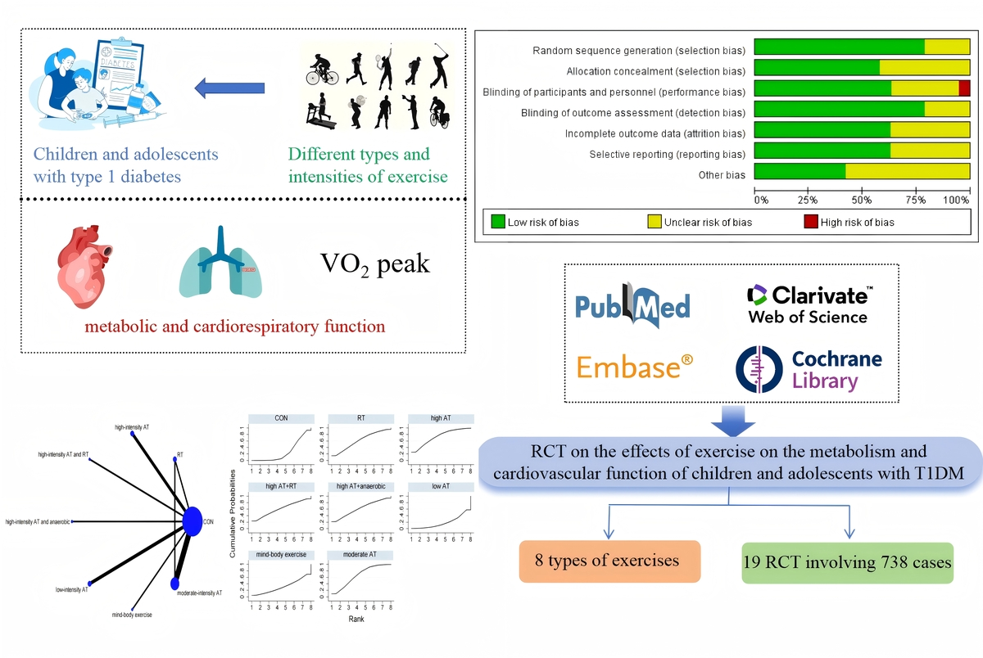

Effects of different types of exercise interventions on metabolic and cardiorespiratory fitness in children and adolescents with type 1 diabetes mellitus: a systematic review and network meta-analysis
DOI: 10.5114/aoms/209000
Arch Med Sci 2025;21(5):1936-1955
Notes:
Introduction
The aim of this study is to assess the effects of various exercise interventions of differing types and intensities (high-intensity aerobic training, moderate-intensity aerobic training, low-intensity aerobic training, high-intensity aerobic training combined with anaerobic training, high-intensity aerobic training combined with resistance training, moderate-intensity aerobic training combined with resistance training, mind-body exercises, and resistance training) on metabolic and cardiorespiratory function in children and adolescents with type 1 diabetes mellitus (T1DM).
Material and methods
Through systematic searches of databases such as PubMed, Embase, Cochrane, and Web of Science, randomized controlled trials (RCTs) were gathered to examine the effects of eight different types and intensities of exercise interventions on the metabolic and cardiorespiratory functions of children and adolescents with T1DM.
Results
A total of 19 RCTs involving 738 children and adolescents with T1DM were included. The network meta-analysis (NMA) results showed that high-intensity aerobic training combined with anaerobic training and high-intensity aerobic training significantly reduced the patients’ lipid profile, including total cholesterol (TC) (MD = –1.92, 95% CI = (–2.36, –1.48)), low-density lipoprotein cholesterol (LDL-C) (MD = –1.18, 95% CI = (–1.94, –0.42)), and increased high-density lipoprotein cholesterol (HDL-C) (MD = 1.63, 95% CI = (1.21, 2.05)).
Conclusions
Based on NMA and surface under the cumulative ranking curve (SUCRA) rankings, it was concluded that high-intensity aerobic training combined with anaerobic training and high-intensity aerobic training can improve the metabolic and cardiorespiratory functions of children and adolescents with T1DM, although they did not show significant effects on hemoglobin A1c (HbA1c), blood glucose (BG), peak oxygen consumption (VO2 peak), or triglycerides (TG).

