Slide 1
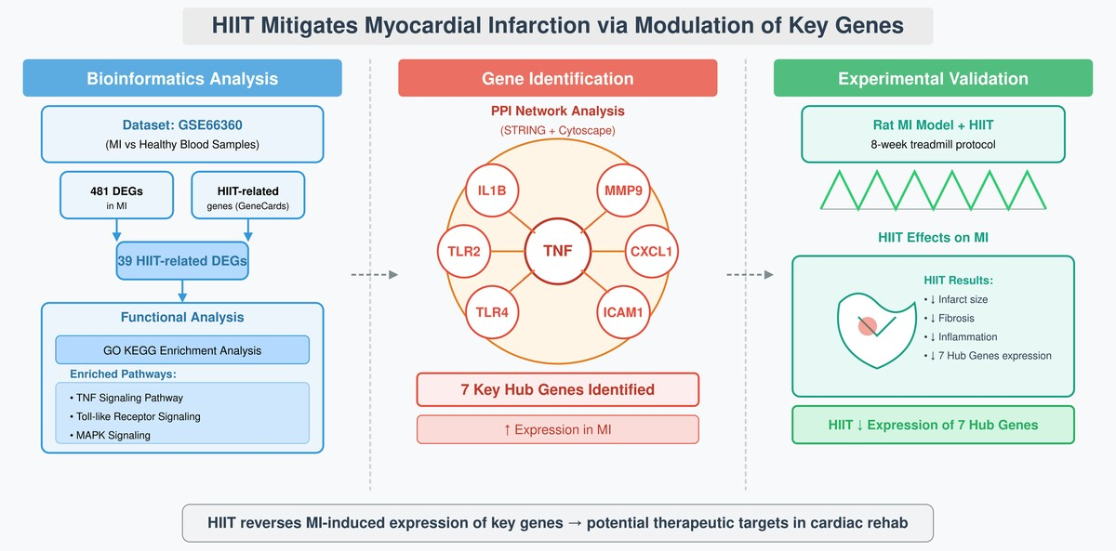

High-intensity interval training: unveiling seven key genes mediating cardioprotection in myocardial infarction
DOI: 10.5114/aoms/209044
Arch Med Sci 2025;21(6):2476-2492
Notes:
Introduction
Myocardial infarction (MI) is a leading cause of mortality, driven by inflammation and cardiac remodeling. While high-intensity interval training (HIIT) improves MI outcomes, its molecular mechanisms remain poorly defined, limiting therapeutic optimization. This study aimed to identify molecular targets and signaling pathways modulated by HIIT in MI, uncovering new therapeutic strategies for cardiovascular recovery.
Material and methods
Differential gene expression analysis of the GSE66360 dataset, comprising circulating endothelial cells from MI patients (n = 49) and healthy controls (n = 50), identified 481 DEGs. Cross-referencing with 717 HIIT-related genes from GeneCards revealed 39 overlapping genes. PPI and functional enrichment analyses highlighted seven hub genes: TNF, IL1B, MMP9, TLR4, ICAM1, TLR2, and CXCL1. These were validated by RT-qPCR in MI patients and controls (n = 20 each). MI was induced in rats (n = 8 per group), followed by an 8-week HIIT regimen. Infarct size, fibrosis, and protein expression were assessed using TTC staining, histology, and Western blot.
Results
We identified 481 DEGs in MI (351 upregulated, 130 downregulated; FDR-adjusted p < 0.05, |log2 fold change| > 1), with 39 overlapping HIIT-related genes. Seven hub genes (TNF, IL1B, MMP9, TLR4, ICAM1, TLR2, CXCL1) were upregulated in MI patients (p < 0.001, RT-qPCR). In MI rats, HIIT reduced infarct size by 32% (p < 0.01), decreased fibrosis and inflammatory cell infiltration (p < 0.05), and downregulated all seven hub genes (p < 0.05). Enrichment analyses linked these genes to TNF and TLR pathways, highlighting HIIT’s anti-inflammatory effects.
Conclusions
HIIT protects the heart after MI by targeting inflammatory and remodeling pathways, providing a basis for precision cardiovascular therapy.

