Slide 1
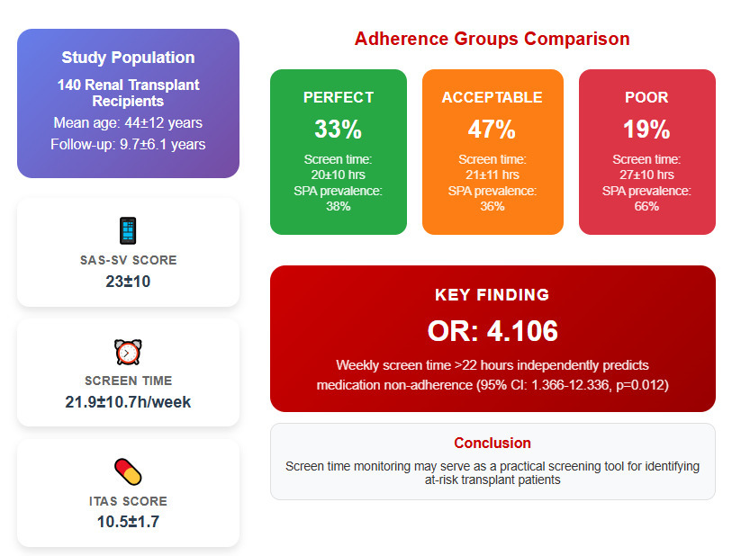

Smartphone addiction as a risk factor for medication non-adherence in renal transplant recipients
DOI: 10.5114/aoms/209207
Arch Med Sci 2025;21(6):2328-2337
Notes:
Introduction
Medication non-adherence (MNA) is a leading cause of graft loss and mortality in renal transplant recipients. Smartphone addiction (SPA) is associated with cognitive impairment and poor time management, but its relationship with MNA remains unclear. This is the first study to investigate the association between SPA and MNA in renal transplant recipients.
Material and methods
This cross-sectional study included 140 renal transplant recipients. SPA was assessed using the Smartphone Addiction Scale-Short Version (SAS-SV) and weekly screen time. MNA was measured using the Immunosuppressant Therapy Adherence Scale (ITAS), classifying adherence as perfect (12), acceptable (10–11), or poor (≤ 9). Univariate and multivariate logistic regression were performed to identify predictors of MNA.
Results
Patients with poor adherence had longer weekly screen time (27 ±10 h) than those with perfect (20 ±10 h) or acceptable adherence (21 ±11 h) (p < 0.001). The poor adherence group had a higher prevalence of SPA (66%) than the perfect (38%) and acceptable adherence groups (36%) (p = 0.020). In univariate analysis, higher SAS-SV scores (p = 0.006) and weekly screen time (p = 0.006) were associated with MNA. In multivariate analysis, only weekly screen time > 22 h remained an independent predictor (OR = 4.106, 95% CI: 1.366–12.336, p = 0.012), while SAS-SV scores lost significance.
Conclusions
Excessive smartphone use, particularly prolonged screen time, is independently associated with MNA in renal transplant recipients. Integrating screen time tracking into routine transplant care may help identify at-risk patients. Future studies should determine whether reducing screen exposure improves adherence.

