Slide 1
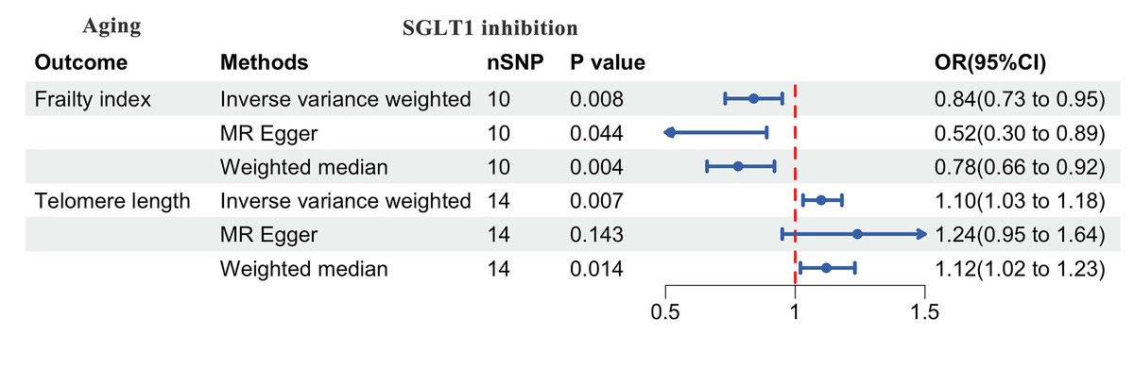

Sodium-glucose cotransporter 1 inhibition may delay aging: a Mendelian randomization study
DOI: 10.5114/aoms/209208
Notes:
Introduction
Previous studies have shown that sodium-glucose cotransporter 2 (SGLT2) inhibition has a significant impact on both cardiovascular disease and aging. However, available evidence on the relationship between sodium-glucose cotransporter 1 (SGLT1) inhibition and aging is currently very limited. We aimed to investigate the causal effect of SGLT1 inhibition on aging by Mendelian randomization (MR) analysis.
Material and methods
The summary-level data for SGLT1 inhibition and aging of European ancestry were extracted from publicly available genome-wide association studies (GWAS). The main analysis used in this study was the random inverse variance weighted (IVW) method. We also employed weighted median and the MR-Egger method as supplementary evidence for IVW results. Sensitivity analyses were performed to assess the stability of the results.
Results
Finally, the exposure data for SGLT1 inhibition were derived from the UK Biobank, including 344,182 European individuals. The GWAS data for telomere length included 472,174 participants, and for frailty index, 175,226 individuals were included. Sixteen single nucleotide polymorphisms (SNPs) that met the SNP screening criteria were retrieved. The results indicated that SGLT1 inhibition increases telomere length (odds ratio [OR]IVW = 1.10, 95% CI: 1.03–1.18; p = 0.007) and reduces the frailty index (OR IVW = 0.84, 95% CI: 0.73–0.95; p = 0.008). No evidence of significant pleiotropy or heterogeneity was observed, which was further substantiated by the sensitivity analysis results.
Conclusions
The present study determined that SGLT-1 inhibition exhibited a significant negative correlation with aging, suggesting a theoretical basis for the strategy of delaying the aging process.

