Slide 1
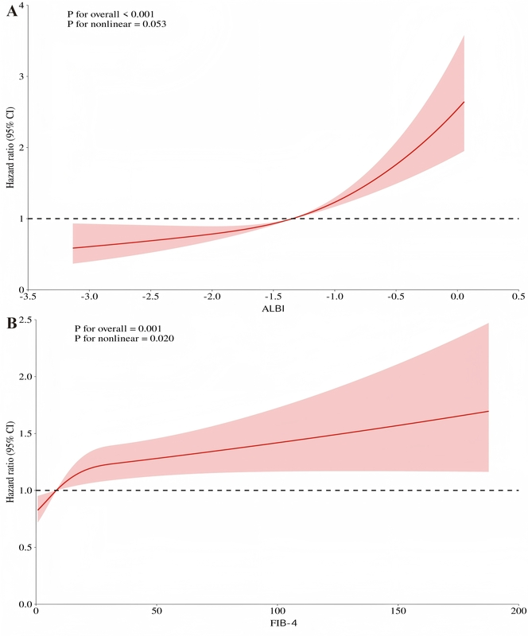

Relationship between albumin-bilirubin score, Fibrosis-4 index and 28-day mortality in critically ill cirrhotic patients: a retrospective cohort analysis and machine learning-driven prediction models
DOI: 10.5114/aoms/209545
Notes:
Introduction
Critically ill patients with cirrhosis face substantially increased mortality. Reliable prognostic tools are essential for risk stratification and to guide clinical decision-making. Although prior studies have explored the predictive value of the albumin-bilirubin score (ALBI) and Fibrosis-4 (FIB-4) index in compensated cirrhosis and liver cancer, their role in predicting mortality among critically ill patients with cirrhosis has remained insufficiently investigated. This study was conducted to evaluate these associations in this high-risk population.
Material and methods
Data for 2,139 critically ill cirrhotic patients were drawn from Version 3.1 of the MIMIC-IV database. Associations were analyzed using restricted cubic splines and Cox proportional hazards regression. Survival analyses were performed using Kaplan-Meier curves. Feature importance of the ALBI score and FIB-4 index was assessed using the Boruta algorithm, and machine learning-driven predictive models were developed.
Results
Elevated ALBI scores were strongly correlated with increased 28-day all-cause mortality risk in patients with cirrhosis (HR = 1.69;95% CI: 1.48–1.93; p < 0.05). The FIB-4 index exhibited similar prognostic relevance. Boruta’s feature selection indicated that both scores had high Z scores. Among predictive models, the random survival forest (RSF) approach performed best (AUC = 0.832).
Conclusions
The ALBI and FIB-4 scores are strongly associated with 28-day all-cause death rates in critically ill cirrhotic patients. Higher ALBI scores and FIB-4 index values are associated with greater mortality risks. Predictive models based on machine learning show strong performance. These findings suggest that the ALBI and FIB-4 scores may serve as potential predictors of adverse outcomes in critically ill cirrhotic patients.

