Slide 1
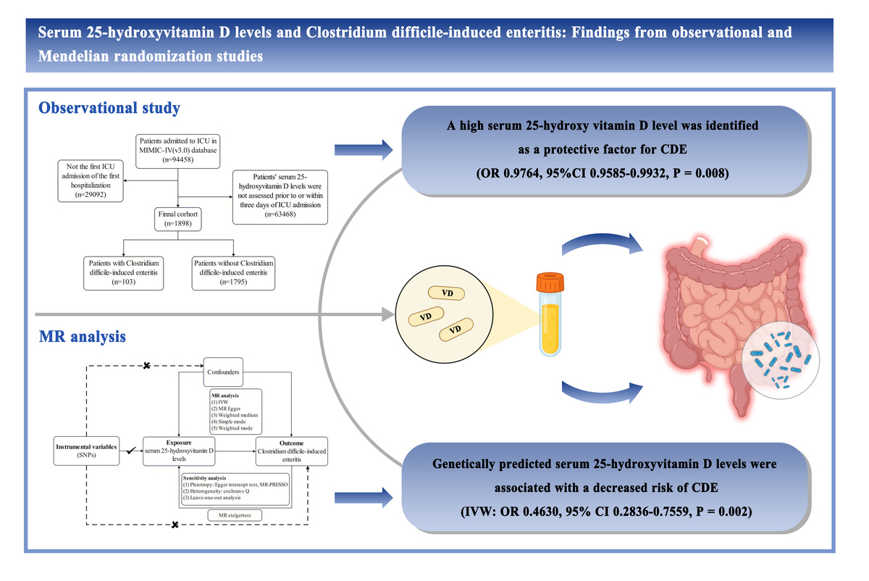

Serum 25-hydroxyvitamin D levels and <i>Clostridioides difficile</i>-induced enteritis: findings from observational and Mendelian randomization studies
DOI: 10.5114/aoms/209548
Arch Med Sci 2026;22(3):1588-1595
Notes:
Introduction
The association between serum 25-hydroxyvitamin D levels and <i>Clostridioides difficile</i>-induced enteritis (CDE) is ambiguous. This study investigated the association and potential causal relationship between serum 25-hydroxyvitamin D levels and the risk of CDE.
Material and methods
In this real-world observational study, a total of 1898 participants, including 103 patients with CDE and 1795 non-CDE controls, were selected from the Medical Information Mart for Intensive Care IV (MIMIC-IV) database. Logistic regression and restricted cubic spline (RCS) analyses were used to evaluate the association between serum 25-hydroxyvitamin D levels and the risk of CDE. To assess the potential causal relationship between the two factors, two-sample Mendelian randomization (MR) analysis was performed.
Results
After adjustments were made for multiple confounders, a high serum 25-hydroxyvitamin D level (odds ratio [OR] = 0.9764; 95% confidence interval [CI], 0.9585–0.9932; p = 0.008) was independently associated with a lower risk of CDE. Similarly, the RCS model demonstrated a linear inverse correlation between serum 25-hydroxyvitamin D levels and the risk of CDE (p for non-linear = 0.165). Furthermore, MR analysis showed that genetically predicted serum 25-hydroxyvitamin D levels were associated with a decreased risk of CDE (IVW: OR = 0.4630; 95% CI: 0.2836–0.7559; p = 0.002). Sensitivity analysis did not show evidence of potential heterogeneity or horizontal pleiotropy.
Conclusions
This study suggests that low serum 25-hydroxyvitamin D levels are associated with an increased risk of CDE, and this relationship is potentially causal.

