Slide 1
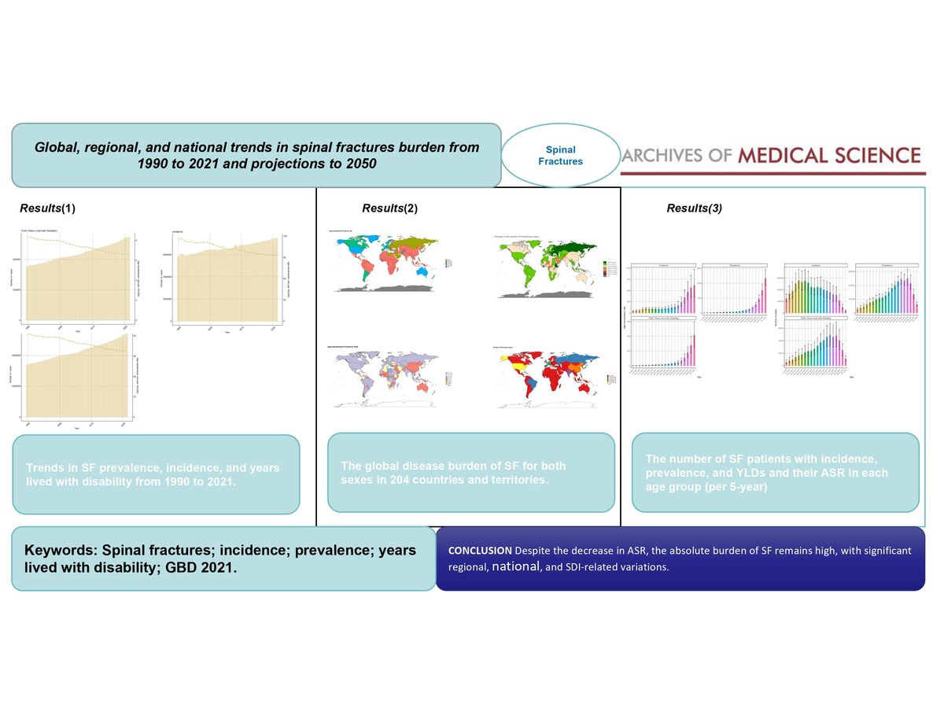

Global, regional, and national trends in spinal fracture burden from 1990 to 2021 and projections to 2050
DOI: 10.5114/aoms/209584
Arch Med Sci 2026;22(1):250-269
Notes:
Introduction
Spinal fractures (SF) remain a major global cause of disability. This study aimed to quantify the global incidence, prevalence, and burden of SF in 2021, along with temporal trends from 1990 to 2021. These trends are stratified by location, age, sex, and Socio-Demographic Index (SDI). Furthermore, the study provides projections for the burden of SF over the next 30 years.
Material and methods
Data for this study were obtained from the 2021 Global Burden of Disease Study (GBD). To quantify temporal patterns and evaluate trends in age-standardized rates (ASR) of SF prevalence (ASPR), incidence (ASIR), and age-standardized years lived with disability (ASYR), estimated annual percentage changes (EAPCs) were calculated for the study period. The analyses were stratified by gender, 20 age categories, 21 GBD regions, 204 countries/territories, and 5 SDI quintiles. Statistical analyses and plot visualizations were performed using the R statistical package (version 4.4.2).
Results
In 2021, the global burden of SF remained considerable, with a total of 3.4 million cases and an ASPR of 65.19 cases per 100,000 individuals (95% uncertainty interval [UI]: 56.89–75.28). The ASIR was 92.75 per 100,000 individuals (95% UI: 72.12–119.99), while the ASYR was 6.62 per 100,000 individuals (95% UI: 4.43–9.2). Regionally, the highest ASPR, ASIR, and ASYR were observed in high SDI regions, while the lowest rates were found in low SDI regions.
Conclusions
Geographically, Australasia exhibited the highest ASIR and ASPR, while the Caribbean had the highest ASYR. Among countries, New Zealand had the highest ASIR, and Andorra showed the highest ASPR and ASYR.

