Slide 1
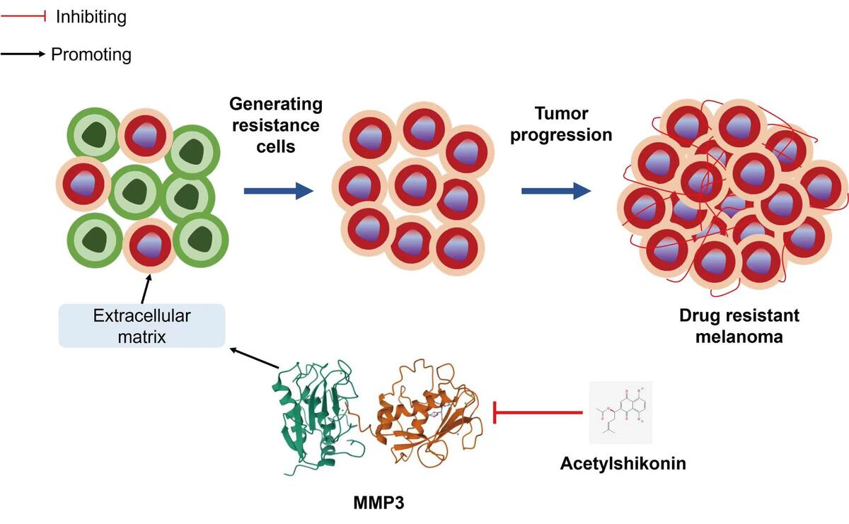

Acetylshikonin (AceS) inhibited drug-resistant melanoma via downregulating matrix metalloproteinase-3 (MMP3)
DOI: 10.5114/aoms/209585
Notes:
Introduction
Drug resistance has become a huge challenge in melanoma. This study aimed to explore the molecular mechanism by which acetylshikonin (AceS) inhibits melanoma with drug resistance to BRAF inhibitor (BRAFi).
Material and methods
To identify potential targets of AceS in drug-resistant melanoma, we intersected AceS targets predicted by SwissTargetPrediction and differentially expressed genes in drug-resistant melanoma identified from the GSE203545 dataset. Drug-resistant M14 cells were treated with AceS with or without PLX4720, a BRAFi. Cell proliferation, migration, invasion, and apoptosis were investigated. MMP3 was quantified by qPCR and immunofluorescence. Extracellular matrix (ECM) was evaluated by MMP1 and MMP9. Also, drug-resistant M14 cells were transfected by MMP3 siRNA. Moreover, drug-resistant M14 cells with MMP3 overexpression were treated with AceS. In vivo, a subcutaneous tumor-bearing nude mouse model was established to validate the effects of AceS in drug-resistant melanoma.
Results
MMP3 was found to be the key target of AceS in drug-resistant melanoma. AceS significantly inhibited proliferation, migration, and invasion (p < 0.05), and promoted apoptosis (p < 0.05); it could increase the sensitivity of drug-resistant M14 cells to PLX4720 (p < 0.05). MMP3 silencing contributed to the decreases in proliferation, migration, and invasion, and the increased apoptosis (p < 0.05). Significantly, MMP3 overexpression reversed the effects caused by AceS (p < 0.05). AceS inhibited tumor growth; it reduced MMP1, MMP3, and MMP9 in vivo. AceS promoted tumor sensitivity to PLX4720 in vivo.
Conclusions
AceS downregulated MMP3 to modulate ECM remodeling, thereby inhibiting drug-resistant melanoma, and enhanced the cell response to BRAFi. Our findings provide intriguing insights into drug-resistant melanoma.

