Slide 1
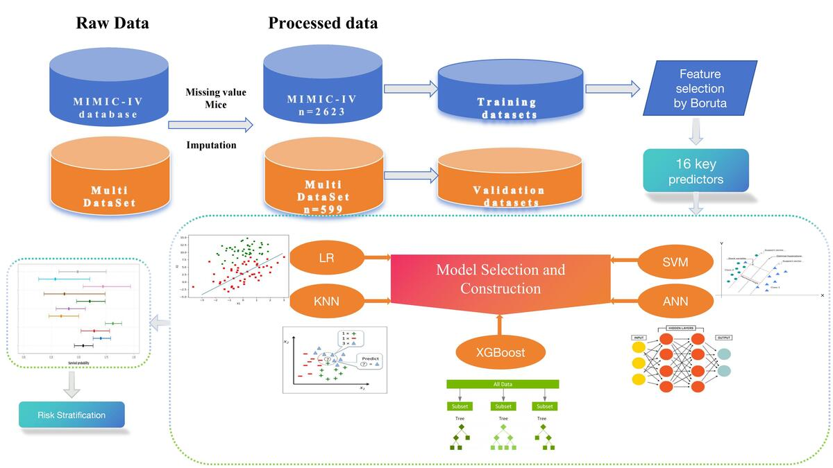

Machine learning prediction of early hypothermia in sepsis patients
DOI: 10.5114/aoms/209620
Arch Med Sci 2026;22(4):2058-2067
Notes:
Introduction
Sepsis is a systemic inflammatory response syndrome caused by infection and remains a leading cause of mortality worldwide. Abnormal body temperature, especially hypothermia (body temperature < 36°C), is a key clinical feature in sepsis patients and is closely associated with disease severity, impaired immune function, and poor prognosis. Early prediction of hypothermia is crucial for timely intervention and improving prognosis.
Material and methods
This study used machine learning algorithms to train and validate a prediction model for early temperature changes in critically ill sepsis patients. Data were extracted from the MIMIC-IV database and five models were established: XGBoost, LR, SVM, KNN, and ANN.
Results
The XGBoost model demonstrated the best predictive performance with AUC values of 0.92 in the training cohort and 0.98 in the validation cohort.
Conclusions
This model can assist clinicians in identifying sepsis patients at high risk for early hypothermia and implementing early intervention to reduce mortality.

