Slide 1
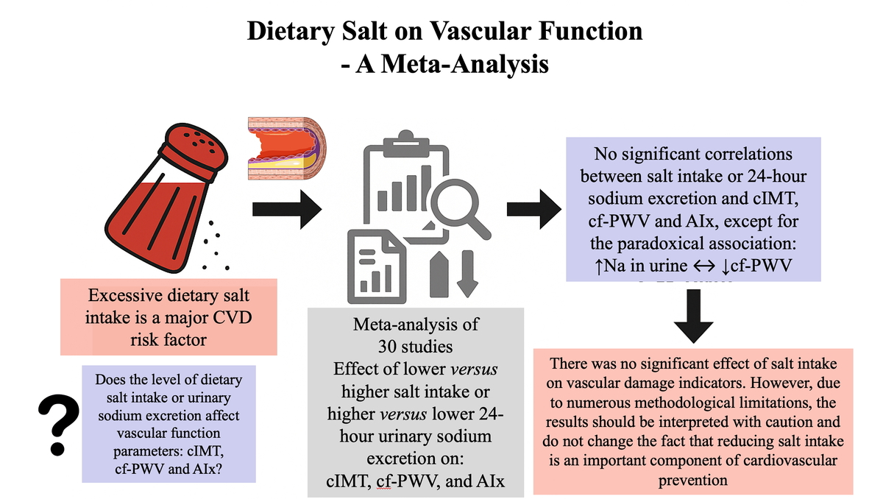

Dietary salt on vascular function: a meta-analysis
DOI: 10.5114/aoms/209720
Arch Med Sci 2025;21(4):1631-1635
Notes:
Introduction
Material and methods
Results
Conclusions

