Slide 1
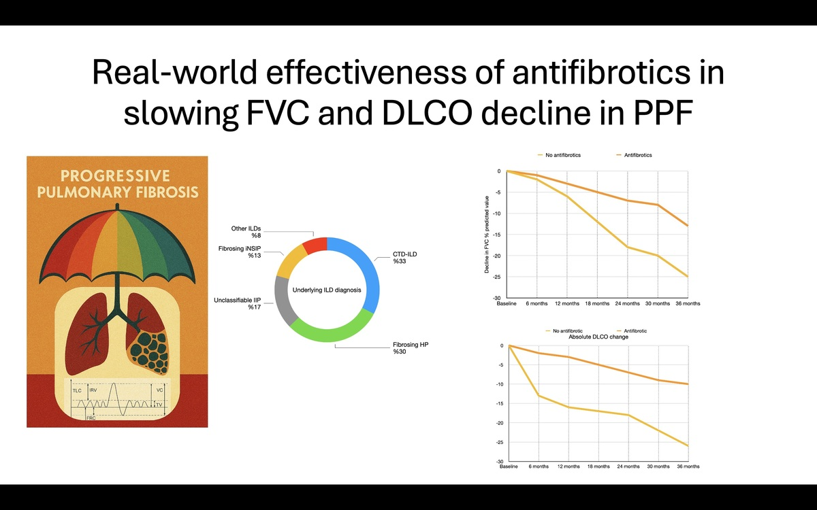

Efficacy of Antifibrotics in Slowing FVC and DLCO Decline in Progressive Pulmonary Fibrosis: A Real World Experience
DOI: 10.5114/aoms/210329
Notes:
Introduction
A few real-world studies have investigated the effectiveness of antifibrotics in patients with progressive pulmonary fibrosis (PPF). Aim of this study was to evaluate the real-life efficacy of antifibrotics in PPF.
Material and methods
In this, real-world study; medical records of patients with non-IPF (idiopathic pulmonary fibrosis) fibrosing ILD (interstitial lung disease) between January 2013 to December 2023 were examined retrospectively. Patients with PPF were included and classified into two groups: antifibrotic group (pirfenidone or nintedanib) and non-antifibrotic group. FVC, DLCO decline, exacerbations and mortality were compared between the groups.
Results
A total of 406 patients with ILD were examined. 262 patients had fibrotic ILD other than IPF, and of 126 with progressive phenotype were included. 41 (32.5%) had a connective tissue disease associated ILD, 38 (30.2%) chronic fibrosing hypersensitivity pneumonitis, 21 (16.7%) unclassifiable idiopathic interstitial pneumonia, 16 (12.7%) idiopathic fibrosing non-specific interstitial pneumonia, and 10 (7.9%) other ILDs. At 36 months, FVC % predicted value declined by 13% in the antifibrotic group vs. 25% in the non-antifibrotic group (p<0.001); DLCO declined by 10% vs. 26%, respectively (p<0.001). Exacerbations and mortality were lower in patients receiving antifibrotics (29% vs 6%, OR:6.38, p<0.001; 21% vs 5%, OR:5.59 p=0.006; respectively). The rate of adverse events leading to treatment discontinuation was %9 in patients receiving pirfenidone and 25.6% with nintedanib (p=0.19).
Conclusions
Our real-world results show that antifibrotics reduced both DLCO and FVC decline, exacerbations and mortality in PPF. Adverse events that should not be neglected lead to a considerable rate of discontinuation.

