Slide 1
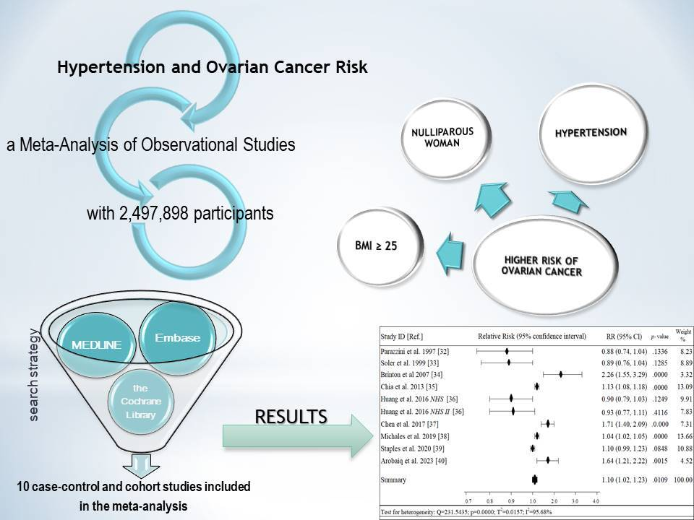

Hypertension and ovarian cancer risk: a meta-analysis of observational studies
DOI: 10.5114/aoms/210330
Arch Med Sci 2026;22(3):1609-1617
Notes:
Introduction
Ovarian cancer is the eighth most common cancer among women and an important cause of cancer-related mortality, particularly in high-income countries. Scientific studies show that hypertension may play a significant role in the initiation of cancer. Therefore, we conducted the first meta-analysis to comprehensively examine the association between hypertension and ovarian cancer risk.
Material and methods
We performed a literature search of all of the observational studies published as original articles from inception to July 2024, and we searched the following electronic databases: PubMed, Embase, and Cochrane Library. Finally, we included ten full-text cohort and case-control studies addressing the effect of hypertension on ovarian cancer in this meta-analysis. Our study was preregistered with International Prospective Register of Systematic Reviews (PROSPERO CRD42024565574) and followed the PRISMA statement. Effect size was presented as risk ratios (RRs) and 95% confidence intervals (CIs). Heterogeneity test evaluation was performed using Cochran’s Q test and I2 statistics.
Results
The meta-analysis included a total of 2,497,898 women. There was a statistically significant association (RR = 1.10, 95% CI: 1.02–1.23, p < 0.011) between hypertension and ovarian cancer risk. Subgroup analysis showed that parity may significantly reduce the ovarian cancer risk, which was higher among women who had never given birth (RR = 1.43, p < 0.0025), while a body mass index (BMI) > 25 kg/m2 increased the risk of ovarian cancer (RR = 1.12, p < 0.0001).
Conclusions
The findings of this comprehensive review and meta-analysis indicate that hypertension is associated with higher overall risk of ovarian cancer. While the present data provide novel evidence, further prospective studies are needed to elucidate the association between hypertension and ovarian cancer risk.

