Slide 1
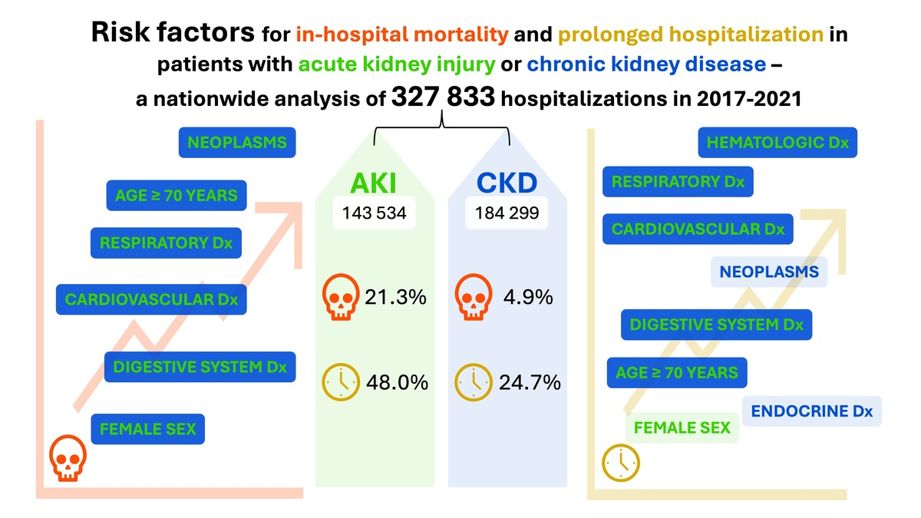

Risk factors for in-hospital mortality and prolonged hospitalization in patients with acute kidney injury or chronic kidney disease: a nationwide analysis of 327 833 hospitalizations in 2017–2021
DOI: 10.5114/aoms/210331
Notes:
Introduction
Kidney disease is recognized as a major global health burden. However, nationwide studies on hospitalization outcomes related to acute kidney injury (AKI) and chronic kidney disease (CKD) in Poland are lacking. The objective of this study was to identify risk factors for in-hospital mortality and prolonged length of stay among patients hospitalized due to AKI or CKD in Poland. It is the first nationwide analysis to evaluate these outcomes in this patient population.
Material and methods
This is a retrospective nationwide analysis of hospital discharge records of adult patients hospitalized due to a primary diagnosis of AKI (ICD-10 N17) or CKD (ICD-10 N18) between 2017 and 2021 in Poland. Risk factors for in-hospital mortality (death during hospitalization) and prolonged stay (≥ 8 days) were identified using logistic regression.
Results
Among 327 833 eligible hospitalizations, AKI accounted for 143 534 cases (mortality 21.3%; prolonged hospitalization 48%) and CKD for 184 299 cases (mortality 4.9%; prolonged hospitalization 24.7%). Significant risk factors for in-hospital mortality included female sex, age ≥ 70 years, neoplasms, and cardiovascular, respiratory, and digestive system diseases for both AKI and CKD. Prolonged hospitalization was associated with female sex, age ≥ 70 years, and hematologic, cardiovascular, respiratory, and digestive system diseases for AKI; and with age ≥ 70 years, neoplasms, and hematologic, endocrine, cardiovascular, respiratory, and digestive system diseases for CKD.
Conclusions
The study identified key risk factors for in-hospital mortality and prolonged hospitalization among patients with AKI or CKD. The findings may guide clinical risk stratification.

