Slide 1
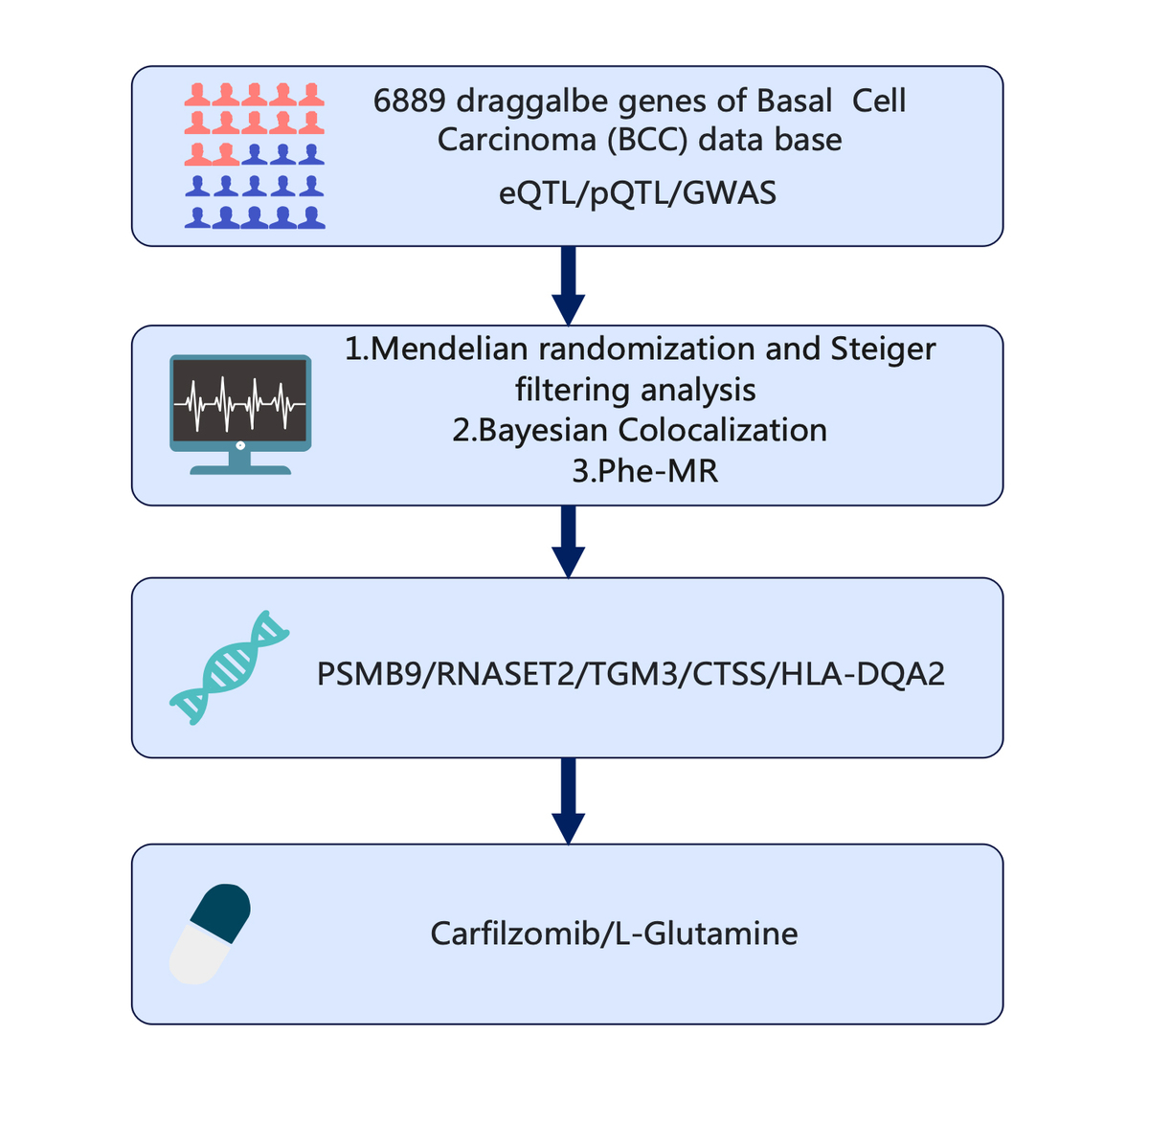

Systematic druggable genome-wide Mendelian randomization identifies therapeutic targets for basal cell carcinoma
DOI: 10.5114/aoms/210332
Notes:
Introduction
Basal cell carcinoma (BCC) is the most common type of skin cancer, with its incidence increasing annually, posing a significant challenge to public health. Currently, the treatment of BCC mainly includes surgical resection, radiotherapy, and pharmacotherapy. However, for high-risk or recurrent BCC cases, traditional treatments may be limited in efficacy, and there is an urgent need to explore more effective targeted therapeutic strategies. This study aims to identify and validate potential druggable genes for BCC treatment by integrating multi-omics and pharmacogenomics approaches.
Material and methods
Utilizing pharmacogenomics, transcriptomics, proteomics, and genome-wide association study (GWAS) data, we employed Mendelian randomization (MR) and Bayesian colocalization analyses to identify genes associated with BCC development. Phenome-wide Mendelian randomization (Phe-MR) analysis was further conducted to elucidate the causal relationships between these genes and various disease phenotypes.
Results
The study identified PSMB9, TGM3, CTSS, HLA-DQA2, and RNASET2 as potential drug targets, with PSMB9 and RNASET2 positively correlated with BCC risk, while CTSS showed a negative correlation. Additionally, carfilzomib and L-glutamine were identified as existing compounds with potential therapeutic agents.
Conclusions
The strength of this study lies in its integrative approach, which not only enhances the reliability of the findings but also provides new possibilities for targeted drug development. Phe-MR analysis ensured the safety of the candidate genes and provided guidance for future targeted drug development. The results highlight the importance of further exploring these druggable genes and underscore the value of MR analysis in drug discovery, offering new therapeutic strategies for BCC and directions for future research.

