Slide 1
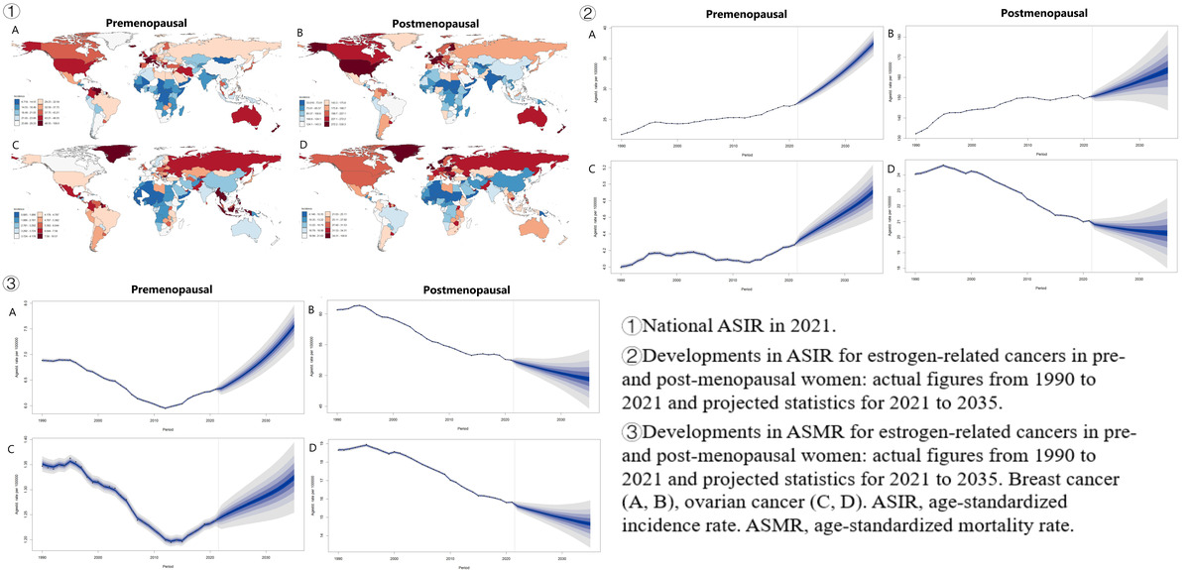

Global burden and developments in pre- and post-menopausal estrogen-related cancer from 1990 to 2021, with estimates for 2035
DOI: 10.5114/aoms/210383
Arch Med Sci 2025;21(5):1861-1873
Notes:
Introduction
The global prevalence of estrogen-related cancers is often underappreciated, with a significant impact on women’s health. Our goal is to explore the patterns and trends in estrogen-related cancers among women, both pre- and post-menopausal, spanning from 1990 to 2021. We conducted secondary analyses to assess the burden of estrogen-related cancers using data from GBD 2021.
Material and methods
We sourced data from the Global Burden of Disease Study (GBD) 2021, focusing on the incidence, mortality, and disability-adjusted life years (DALYs) for two predominant estrogen-related cancers: breast and ovarian cancer. This data encompassed 204 countries and territories, covering a period from 1990 to 2021. We calculated the estimated annual percentage changes (EAPC) across different age groups and socio-demographic indices (SDIs) to assess the evolving trends over time. Spearman’s correlation analysis was employed to scrutinize the relationship between age-standardized rates and SDI. Furthermore, we utilized the Bayesian age-period-cohort model to forecast the trajectory of estrogen-related cancers from 2021 to 2035.
Results
From 1990 to 2021, the global age-standardized incidence rate (ASIR) for pre- and post-menopausal breast cancer and premenopausal ovarian cancer increased, while postmenopausal ovarian cancer declined. Meanwhile, the DALY and age-standardized mortality rate (ASMR) for two cancers showed a downward trend worldwide. Breast cancer is prevalent globally, followed by ovarian cancer, highlighting the disparities in the burden of estrogen-related cancers across different regions. Worldwide, the burden patterns of estrogen-related cancers differ significantly between pre- and post-menopausal women. In 2021, a strong positive correlation was found between the ASIR of two cancers and the ASMR of ovarian cancer with SDI (r > 0, p < 0.05), while a negative correlation existed between the ASMR of premenopausal breast cancer concerning SDI (r < 0, p < 0.05). Except for a drop in ASIR for postmenopausal ovarian cancer from 2021 to 2035, the ASIR for pre- and post-menopausal breast and premenopausal ovarian cancer is expected to rise. Predictions indicate an increase in the ASMR and DALYs for premenopausal estrogen-related cancers, while a decrease is expected for postmenopausal ones.
Conclusions
Estrogen-related cancers remain a major global health issue, with increasing burden. It is crucial for policymakers to stay informed about these trends, develop targeted screening strategies based on age and region, and allocate resources effectively.

