Slide 1
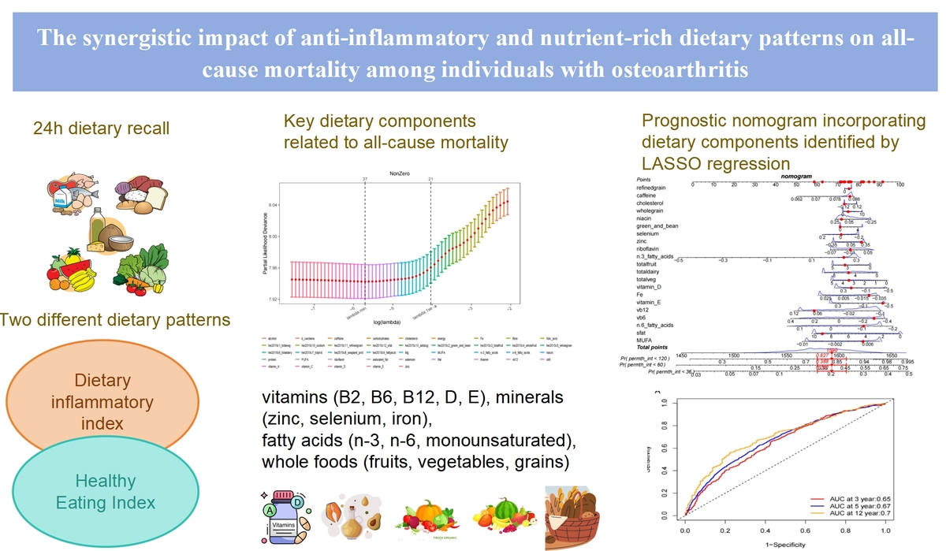

The synergistic impact of anti-inflammatory and nutrient-rich dietary patterns on long-term prognosis among individuals with osteoarthritis
DOI: 10.5114/aoms/210479
Arch Med Sci 2026;22(4):2133-2144
Notes:
Introduction
The aim of the study was to investigate the associations between healthy and anti-inflammatory dietary patterns and mortality risk in osteoarthritis (OA) patients, and to identify key dietary factors influencing long-term outcomes.
Material and methods
We analyzed data from 3,012 OA patients participating in the National Health and Nutrition Examination Survey (NHANES) between 2007 and 2018. Dietary patterns were assessed using two validated indices: the Healthy Eating Index-2015 (HEI-2015) for overall diet quality and the Dietary Inflammatory Index (DII) for inflammatory potential, both derived from 24-hour dietary recall data. Mortality outcomes were ascertained through linkage with the National Death Index. Weighted Cox proportional hazards regression models were employed to evaluate associations between dietary patterns and all-cause mortality, with adjustments for demographic, lifestyle, and clinical confounders. To identify key dietary predictors, we applied Least Absolute Shrinkage and Selection Operator (LASSO) regression. A prognostic nomogram was developed to assess predictive performance.
Results
A healthy, anti-inflammatory diet (high HEI-2015, low DII) was associated with a 14% lower mortality risk (HR = 0.86, 95% CI: 0.75–1.00, p-trend = 0.045) compared to an unhealthy, pro-inflammatory diet. LASSO regression highlighted 21 key dietary factors, including vitamins (B2, B6, B12, D, E), minerals (zinc, selenium, iron), fatty acids (n-3, n-6, monounsaturated), and whole foods (fruits, vegetables, grains). The nomogram showed reliable predictive accuracy (AUC: 0.65 at 3 years, 0.70 at 12 years). Subgroup analyses indicated stronger effects in non-smokers (HR = 0.79, 95% CI: 0.65–0.97).
Conclusions
Adopting a healthy, anti-inflammatory dietary pattern can reduce mortality rates in individuals with arthritis, with specific micronutrients and food groups playing a critical role. Dietary interventions are beneficial for OA management, highlighting the need for further longitudinal and clinical research to establish causal relationships.

