Slide 1
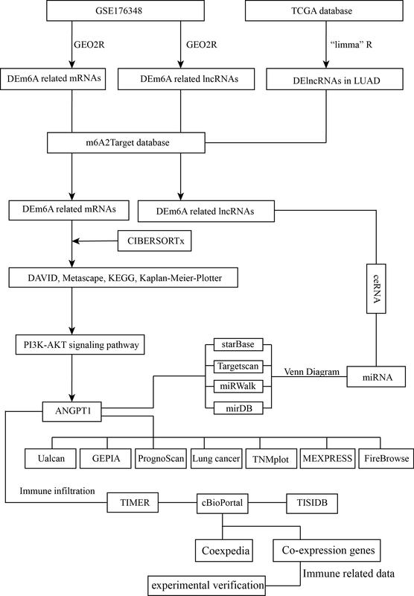

Construction of m6A-related ceRNA networks via epitranscriptomic profiling and their association with immune infiltration in lung adenocarcinoma
DOI: 10.5114/aoms/210481
Notes:
Introduction
The N6-methyladenosine (m6A)-related competing endogenous RNA (ceRNA) network plays a critical role in the occurrence and progression of lung adenocarcinoma (LUAD). This study aimed to investigate the characteristics of m6A-related ceRNAs.
Material and methods
Gene expression matrices and clinical data were obtained from The Cancer Genome Atlas (TCGA) database, along with the GSE176348 dataset sourced from the Gene Expression Omnibus (GEO) database. Differential expression analysis was performed using the “GEO2R” tool and the “limma” R package to identify differentially expressed genes (DEGs). By integrating results from CIBERSORTx and m6A-related databases, we further identified m6A-associated and immune-related genes. The tumor immune microenvironment (TIME) was characterized utilizing the TIMER and TISIDB databases. Finally, differential expression of key molecules between LUAD and normal lung tissues was validated through polymerase chain reaction (PCR).
Results
We found 220 DEGs related to multiple classical tumor pathways using the DAVID and Metascape databases, such as regulation of ERK1, ERK2 cascade, PI3K-AKT signaling pathway and regulation of cell adhesion. By combining the m6A and CIBERSORTx databases, we selected ANGPT1, which was involved in the PI3K-AKT pathways. ANGPT1 expression was lower in LUAD cells than in normal lung cells and associated with patients’ prognosis (p < 0.01). ANGPT1 expression was correlated with PD-L1 (p < 0.01) and multiple immune cells. The PCR results showed that ANGPT1 was expressed at significantly lower levels in A549 cells than in BEAS-2B cell lines.
Conclusions
A validated signature of the m6A-related ceRNA network demonstrated prognostic utility for predicting survival and provides new insights into potential novel therapeutic targets.

