Slide 1
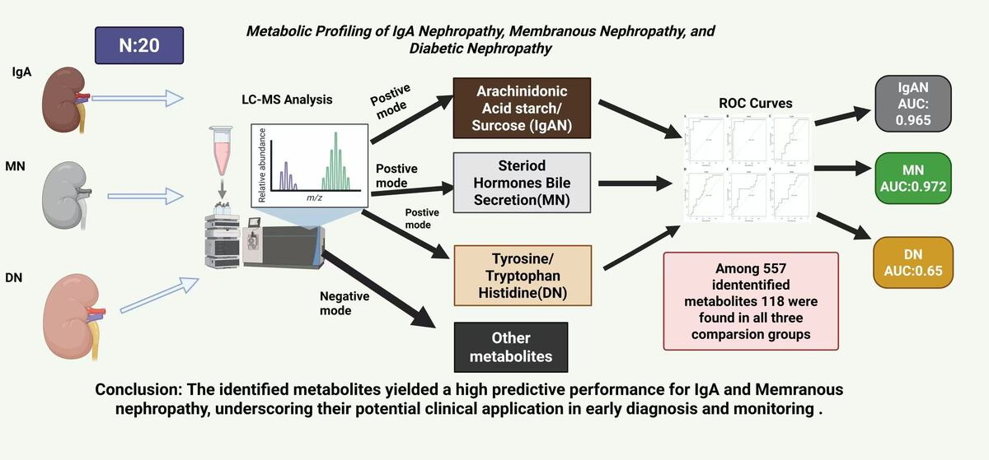

Metabolic profiles of IgA nephropathy, membranous nephropathy, and diabetic nephropathy
DOI: 10.5114/aoms/210616
Arch Med Sci 2026;22(4):2334-2352
Notes:
Introduction
Immunoglobulin A nephropathy (IgAN), membranous nephro­pathy (MN), and diabetic nephropathy (DN) are prominent contributors to chronic kidney disease burden. Our main objective was to contribute to the understanding of the metabolic profiles of these three major types of nephropathies and identify potential metabolic biomarkers.
Material and methods
Kidney samples of 20 sex- and age-matched patients with biopsy-proven IgAN, MN, DN, and controls without any kidney diseases were included. Ultra-high-performance liquid chromatography–mass spectrometry analysis was conducted. The t-test was used to evaluate the statistical significance of the identified metabolites. Metabolic pathways were analyzed using the Kyoto Encyclopedia of Genes and Genomes (KEGG). Specificity, sensitivity, and area under the curve (AUC) were calculated to evaluate the predictive performance of metabolites.
Results
Among 557 identified differential metabolites, only 118 were found in all three comparison groups. Differential metabolites of IgAN vs. controls were significantly enriched in arachidonic acid metabolism, starch and sucrose metabolism, ferroptosis, and other pathways. In the DN group, meta­bolites were mainly enriched in phenylalanine, tyrosine and tryptophan biosynthesis, histidine metabolism, etc. MN-enriched pathways included steroid hormone biosynthesis, neuroactive ligand-receptor interaction, and bile secretion. In the positive mode, cumulative AUC values for comparison pairs IgAN vs. controls, MN vs controls, and DN vs controls were 0.965, 0.972, and 0.573, respectively, whereas in the negative mode the AUC values of all three pairs were slightly above 0.65.
Conclusions
IgAN, MN, and DN have similar but distinct metabolic profiles. Only positive node metabolites of IgAN and MN exhibited high predictive performance.

