Slide 1
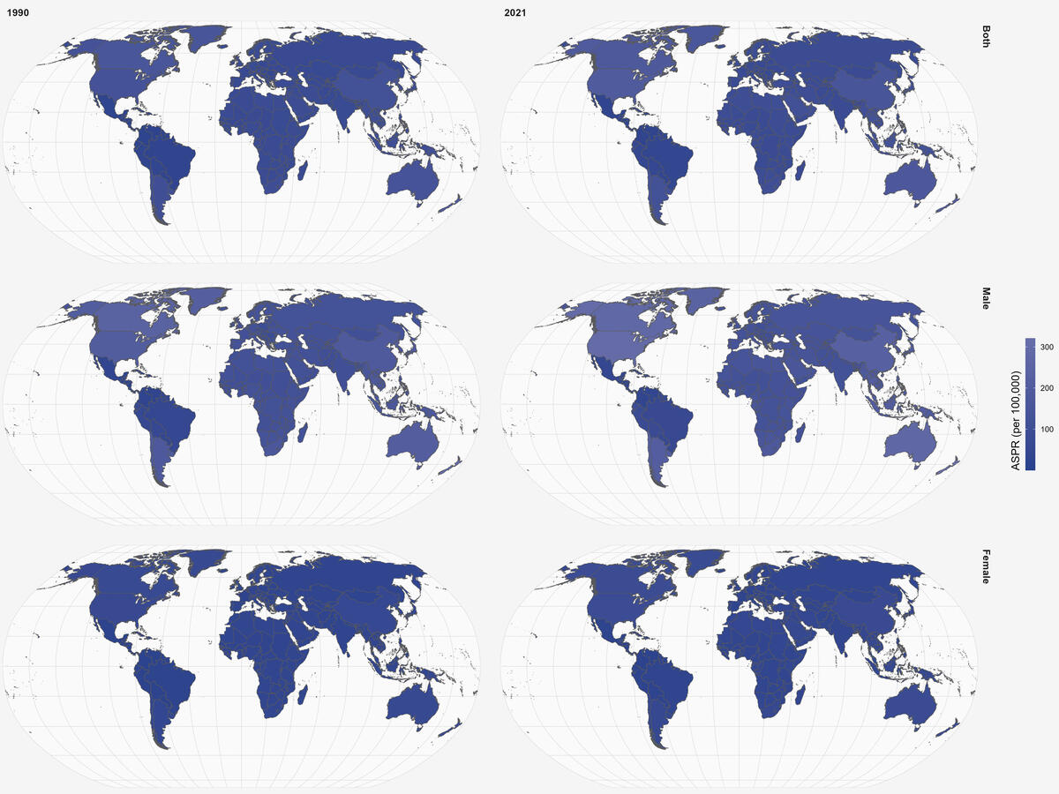

Global burden of ischemic stroke attributable to physical inactivity among adults aged 55 and above: a 32-year analysis (1990–2021)
DOI: 10.5114/aoms/210617
Arch Med Sci 2025;21(5):1683-1696
Notes:
Introduction
Physical inactivity is a well-established risk factor for ischemic stroke, yet the global burden of ischemic stroke attributable to physical inactivity among older adults remains poorly understood. This study aimed to investigate the global burden of ischemic stroke attributable to physical inactivity among adults aged 55 and above from 1990 to 2021, focusing on socioeconomic status, regional variations, and temporal trends.
Material and methods
We calculated death and disability-adjusted life years (DALYs) on a global scale and across various Socio-demographic Index (SDI) regions. To analyze temporal trends, we employed joinpoint regression analysis. The total changes in disease burden were partitioned into three fundamental drivers: aging demographics, population expansion, and epidemiological trends. Additionally, the Bayesian age-period-cohort model was applied to forecast future trends.
Results
The global age-standardized death rate (ASDR) declined from 12.9 (95% UI: –2.3 to 28.6) in 1990 to 8.8 (95% UI: –2.7 to 21.2) in 2021, with an estimated annual percentage change (EAPC) of –1.53 (95% CI: –1.68 to –1.38). High SDI regions experienced the sharpest declines in both deaths and ASDR, while low and low-middle SDI regions showed slower progress. Joinpoint regression analysis revealed distinct temporal trends, with high SDI regions exhibiting the most substantial declines. Decomposition analysis highlighted the contributions of population growth and aging to increased disease burden, while epidemiological changes played a beneficial role in reducing the burden. Age and sex patterns revealed progressive increases in death and DALY rates with age, along with gender disparities, particularly in older age groups. The Bayesian age-period-cohort (BAPC) model projected a U-shaped trend in global ASDR for males and a consistent decline for females by 2050.
Conclusions
This research offers a thorough evaluation of the global impact of ischemic stroke due to physical inactivity in older adults between 1990 and 2021. The results underscore substantial inequalities in socioeconomic status and regional progress, noting particularly slow advancements in low and middle-income countries. The study highlights the necessity for focused interventions, enhanced healthcare accessibility, and robust stroke prevention initiatives to mitigate the global impact of ischemic stroke linked to physical inactivity. Future investigations should concentrate on examining the socio-economic, cultural, and policy-driven factors shaping these trends, thereby informing evidence-based approaches to alleviate the burden of ischemic stroke.

