Slide 1
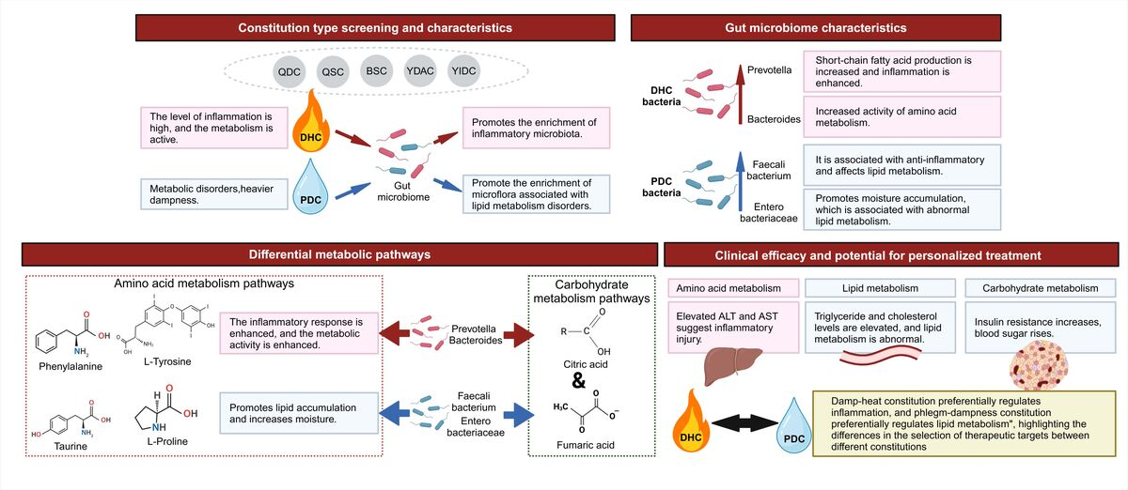

Metabolic Insights into Non-Alcoholic Fatty Liver Disease: Impact of Gut Microbiota and TCM Constitutions
DOI: 10.5114/aoms/210618
Notes:
Introduction
Metabolic dysfunction-associated steatotic liver disease (MASLD) is intricately linked to gut microbiota dysbiosis and is influenced by Traditional Chinese Medicine (TCM) constitution theory. This study explores the fecal microbiota composition in MASLD patients with varied TCM constitutions to unravel the molecular mechanisms underlying the disease.
Material and methods
In this study, 51 MASLD patients and 46 healthy controls were classified into seven TCM constitution groups based on high-throughput sequencing of fecal samples. Analyses were conducted to compare microbial communities, metabolite profiles, and metabolic pathways among these constitution groups. The relationships between specific microbiota and biochemical indicators were evaluated using LEfSe and Spearman correlation analyses.
Results
MASLD patients exhibited reduced fecal microbiota diversity compared to healthy controls, with significant variations in microbial structure among TCM constitution groups. The damp-heat constitution (DHC) and phlegm-dampness constitution (PDC) groups displayed enriched populations of specific microbial species, distinct bacterial taxa, and unique metabolite profiles. Multiple significant pathways related to amino acid, fatty acid, and carbohydrate metabolism were identified through metabolic pathway enrichment analysis. Significant correlations were observed between specific microbial taxa and biochemical indicators such as triglycerides, total cholesterol, alanine aminotransferase (ALT), and aspartate aminotransferase (AST).
Conclusions
This study highlights the close association between alterations in gut microbiota, TCM constitution differences, and MASLD progression. The findings suggest that changes in microbial diversity and metabolite profiles may play a crucial role in MASLD pathogenesis. The identification of constitution-specific microbial variations provides promising targets for personalized interventions and treatment strategies for MASLD.

