Slide 1
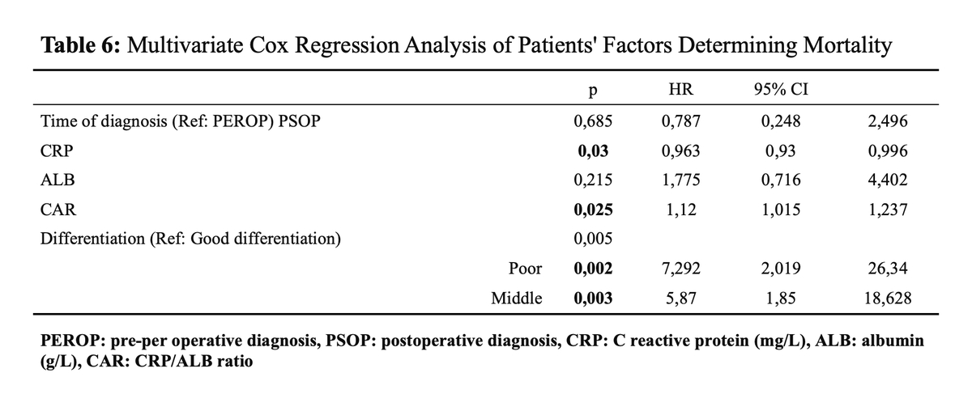

The Effect of Diagnosis Timing on Prognosis and Survival of Gallbladder Cancer
DOI: 10.5114/aoms/210619
Notes:
Introduction
Gallbladder cancer (GBC) is an aggressive cancer with a poor prognosis and an often-asymptomatic course. Here, we investigated the effect of GBC diagnosis time on prognosis and survival.
Material and methods
Sixty-five patients diagnosed with GBC between January 1, 2016, and June 30, 2023, were evaluated for age, gender, laboratory parameters, treatment, diagnosis time, follow-up, survival, and pathological results. Estimated life expectancy and survival rate were calculated, and demographic findings, imaging, pathology, and laboratory results were compared as a function of survival and diagnostic time.
Results
Roughly three quarters of the patients (73.8%) were female; the mean age of the cohort was 65.6±11.9 years (range: 24–93 years). About one third (29.2%) of the patients were diagnosed preoperatively. A statistically significant difference between the groups was detected in terms of priority treatment, tumor differentiation, tumor dimensions, and ALP results. Poor differentiation, high T stage, and high CEA and GGT values were statistically significantly different in the patients who died. Based on univariate analysis, we found that CRP, elevated CAR, low and moderate differentiation, T2, T3, and T4 were all risk factors. On the other hand, elevated ALB was determined to be a protective factor.
Conclusions
The detection of advanced T stage and poor differentiation affect diagnosis and survival, although the correlations are not statistically significant.

