Slide 1
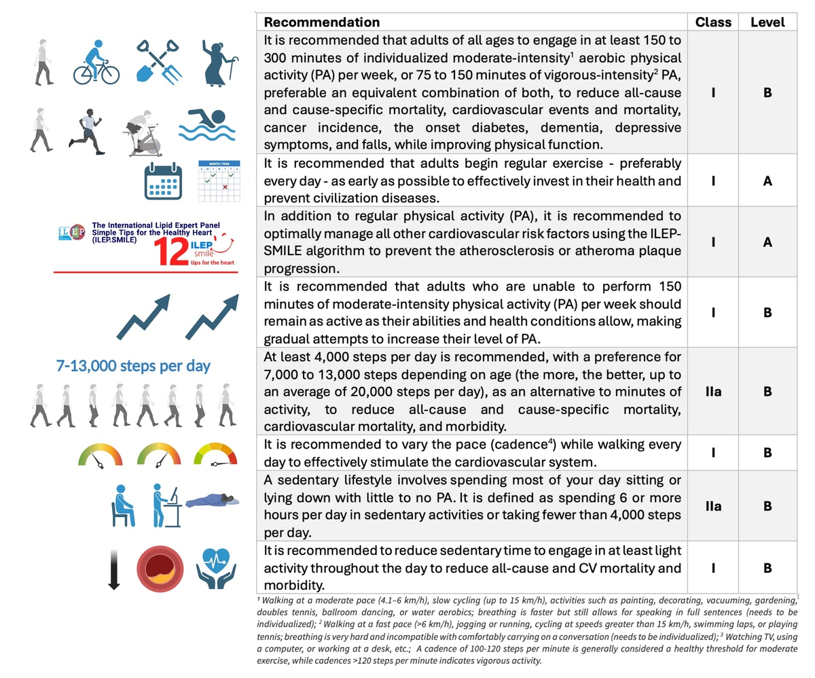

No time to wait: daily step counts should be incorporated into physical activity guidelines
DOI: 10.5114/aoms/210673
Arch Med Sci 2025;21(5):2164-2167

