Slide 1
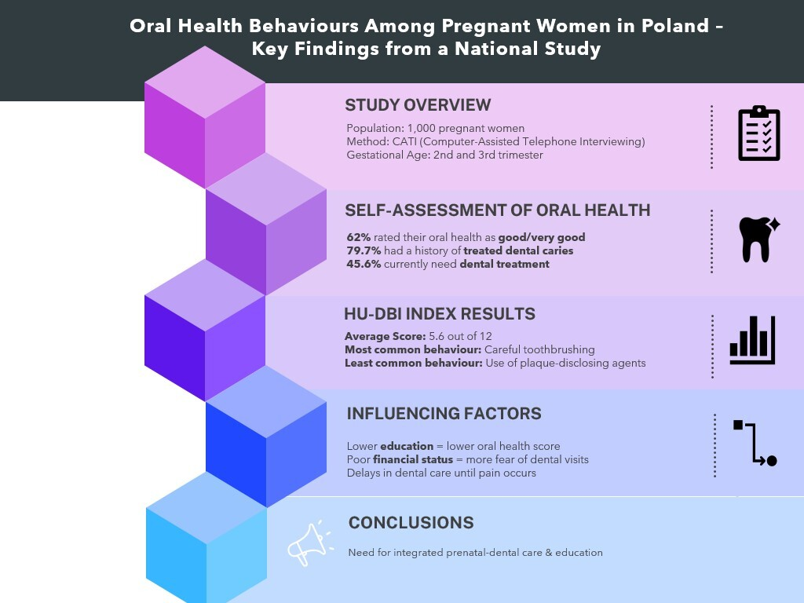

Self-assessed oral health behaviours in pregnant women: a cross-sectional study in the Polish population
DOI: 10.5114/aoms/211150
Arch Med Sci 2026;22(1):188-194
Notes:
Introduction
Pregnant women are at increased risk of developing caries and periodontal disease due to hormonal changes during pregnancy. The main preventive measure is health awareness and behaviours supporting oral hygiene. The aim of this study was to assess oral hygiene health behaviours of pregnant women in Poland.
Material and methods
The study was conducted using the computer-assisted telephone interviewing (CATI) method, in a group of 1,000 women who were in their second or third trimester of pregnancy. The Hiroshima University Dental Behaviour Inventory (HU-DBI) questionnaire was used to assess oral health behaviours. The HU-DBI index was calculated based on 12 questions verifying the respondents’ oral health attitudes and behaviour.
Results
The majority of the women participating in the study (62%) assessed the condition of their teeth as good or very good. At the same time, 79.7% of the women reported a history of dental caries treatment. The mean HU-DBI index was 5.6 points. The most frequently indicated health-promoting behaviour for oral hygiene was careful oral cavity brushing. Analysis of factors influencing self-assessed oral health behaviours showed significant differences in the HU-DBI index according to financial situation and educational level.
Conclusions
Access to dental care should be promoted among pregnant women, regardless of their socioeconomic status. Oral health care measures for pregnant women should include education, prophylaxis, and treatment. It is important to increase the awareness of the expectant mothers that their oral health behaviour has a very strong impact on both their and their children’s health, during the fetal period and from birth on.

