Slide 1
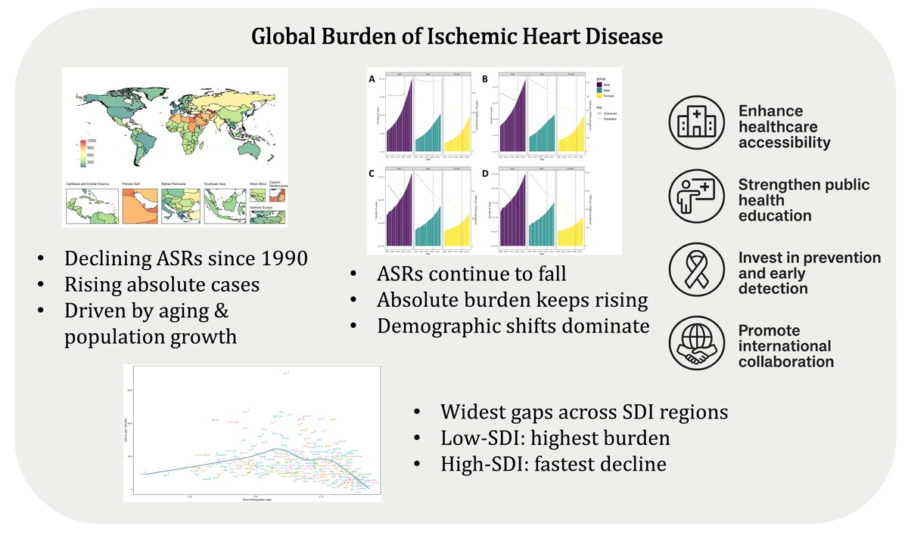

Global burden and cross-country inequalities of ischemic heart disease from 1990 to 2021: an analysis of data from the Global Burden of Disease Study 2021
DOI: 10.5114/aoms/211151
Arch Med Sci 2025;21(5):1756-1771
Notes:
Introduction
To evaluate global trends and SDI-related inequalities in the burden of ischemic heart disease (IHD) from 1990 to 2021, and project trajectories to 2035. This analysis provides crucial evidence to inform health policy and resource allocation for reducing future disparities.
Material and methods
Using Global Burden of Disease (GBD) 2021 data, we analyzed IHD prevalence, incidence, deaths, and disability-adjusted life years (DALYs) across 204 countries. Analyses included temporal trends, decomposition, inequality assessment, and Bayesian projections.
Results
From 1990 to 2021, global age-standardized death rates declined annually by 1.3% and DALYs by 1.2%, while prevalence showed a slight increase (AAPC = 0.03%). High-SDI regions achieved the largest reductions, whereas low- and middle-SDI regions experienced persistent or rising burdens. Decomposition analysis indicated that population growth (110%) and aging (67%) were the main drivers of increasing DALYs, partially offset by epidemiological improvements (–77%). By 2035, despite continued declines in age-standardized rates, the absolute number of IHD cases is projected to increase by 18.2%.
Conclusions
IHD remains a major global health challenge, with substantial SDI-driven disparities that persist despite overall progress. Strengthening prevention in low- and middle-SDI regions, addressing the growing healthcare demands of aging populations, and fostering sustained international collaboration are critical to reducing inequalities, guiding resource allocation, and ultimately alleviating the global burden.

