Slide 1
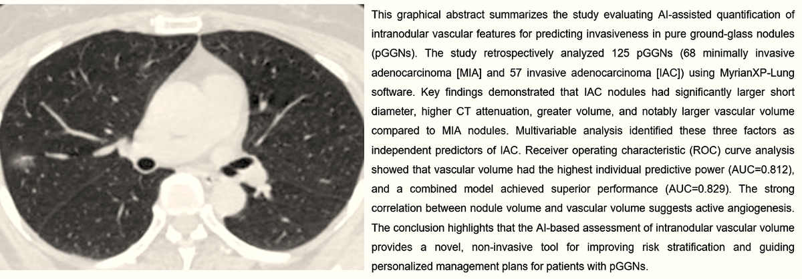

Correlation of Intranodular Vascular Features with Invasiveness in Pure Ground-Glass Nodules of Lung Adenocarcinoma
DOI: 10.5114/aoms/211265
Notes:
Introduction
This study aimed to investigate whether artificial intelligence (AI)-based quantification of intranodular vascular features on computed tomography (CT) scans can predict invasiveness in pure ground-glass nodules (pGGNs) of lung adenocarcinoma.
Material and methods
We conducted a retrospective analysis of 125 surgically resected pGGNs from 112 patients. Preoperative CT images were processed with MyrianXP-Lung software to measure nodule size (long and short diameter, volume), mean CT attenuation (Hounsfield Units, HU), and intranodular vascular volume. Pathological diagnoses were classified into minimally invasive adenocarcinoma (MIA) and invasive adenocarcinoma (IAC). Group comparisons were performed using non-parametric tests, and multivariable logistic regression was applied to identify independent predictors of IAC. Diagnostic performance was assessed using receiver operating characteristic (ROC) curves and area under the curve (AUC) values.
Results
The cohort included 68 MIA and 57 IAC cases. IAC nodules exhibited significantly larger short diameter (8.5 vs 6.1 mm, P<0.001), higher CT attenuation (-532 vs -588 HU, P<0.001), and greater vascular volume (61.2 vs 20.8 mm³, P<0.001) compared to MIA. Multivariable analysis identified short diameter (OR=1.32, P=0.007), CT attenuation (OR=1.012, P=0.001), and vascular volume (OR=1.031, P=0.002) as independent predictors of IAC. Vascular volume showed the highest predictive accuracy (AUC=0.812), with a combined model achieving AUC=0.829. Nodule volume strongly correlated with vascular volume (r=0.905, P<0.001).
Conclusions
AI-assisted vascular volume quantification emerges as a novel predictor of invasiveness in pGGNs. Integration of vascular characteristics with radiological features provides a valuable non-invasive approach for risk stratification and personalized management, underscoring the role of angiogenesis in lung adenocarcinoma progression.

