Slide 1
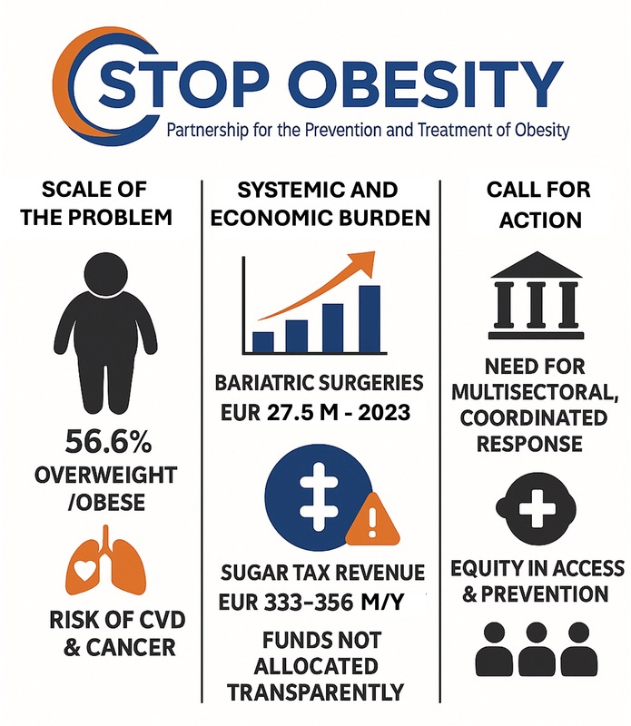

Uniting for the prevention and treatment of obesity: a call for coordinated, multisectoral action on a complex public health challenge
DOI: 10.5114/aoms/211281
Arch Med Sci 2025;21(5):2208-2210

