Slide 1
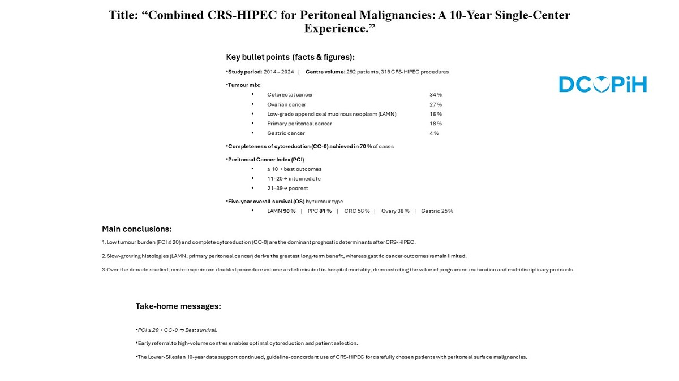

Combined CRS-HIPEC for Peritoneal Malignancies: A 10-Year Single-Center Experience
DOI: 10.5114/aoms/211677
Notes:
Introduction
Peritoneal surface malignancies (PSMs) are challenging to treat due to their locoregional nature and poor response to systemic therapies. Cytoreductive surgery (CRS) combined with hyperthermic intraperitoneal chemotherapy (HIPEC) has emerged as a promising treatment for selected patients, though long-term, real-world data remain limited. Aim of the study: To analyze clinical outcomes, survival patterns, and prognostic factors in a large cohort of patients undergoing CRS-HIPEC over a 10-year period at a national referral center.
Material and methods
This retrospective study included 292 adult patients who underwent 319 CRS-HIPEC procedures between 2015 and 2024. Primary endpoints included overall survival (OS) and postoperative outcomes. Data were stratified by tumor type, Peritoneal Cancer Index (PCI), and Completeness of Cytoreduction (CC-score).
Results
The most common indications were colorectal cancer (34.5%), ovarian cancer (27.0%), low-grade appendiceal mucinous neoplasm (LAMN) (16.1%), primary peritoneal cancer (17.7%), and gastric cancer (3.7%). Complete cytoreduction (CC-0) was achieved in 69.9% of cases. Five-year survival rates were highest in LAMN (90.4%) and primary peritoneal cancer (80.7%), and lowest in gastric cancer (25.0%). Lower PCI (<20) and CC-0 resection were strongly associated with improved survival. Postoperative morbidity declined over time, with no in-hospital mortality since 2022.
Conclusions
CRS-HIPEC offers substantial long-term survival benefits in selected patients with PSMs. Tumor biology, PCI, and completeness of cytoreduction are key prognostic factors. Our findings support expanding access to HIPEC in well-selected cases, particularly in tumors with peritoneal-confined dissemination.

