Slide 1
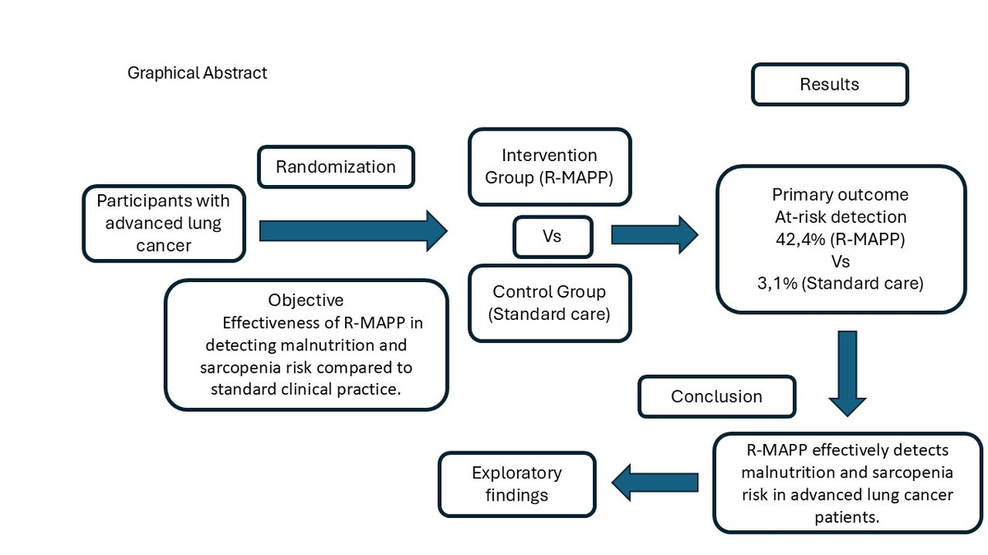

Detection of malnutrition and sarcopenia risk in patients with advanced lung cancer using the R-MAPP tool
DOI: 10.5114/aoms/211886
Notes:
Introduction
Malnutrition and sarcopenia are frequent in advanced lung cancer, worsening outcomes and quality of life. Early detection and intervention are essential. This study assessed the effectiveness of R-MAPP in detecting malnutrition and sarcopenia risk compared to standard clinical practice.
Material and methods
A prospective, randomized, multicenter study of 65 advanced lung cancer patients assigned to R-MAPP or standard care was performed. R-MAPP integrates MUST and SARC-F with clinical data. Outcomes included risk identification, weight, quality of life (EQ-5D-5L), and handgrip strength. Analyses were adjusted for baseline imbalances (alcohol use, chemotherapy).
Results
The R-MAPP group identified 42.4% of patients at risk vs. 3.1% in the control group (p < 0.001). After adjustment, R-MAPP markedly increased the likelihood of detecting at-risk patients (adjusted OR = 21.2, 95% CI: 2.6–175.4, p = 0.005). No significant differences were observed in weight (4.94 kg, 95% CI: –4.59–14.48, p = 0.30) or quality of life (–8.45 VAS points, 95% CI: –22.62–5.71, p = 0.23), although both remained stable despite a higher chemotherapy rate in the intervention group.
Conclusions
R-MAPP effectively identifies patients at risk of malnutrition and sarcopenia in advanced lung cancer, supporting early intervention in complex clinical settings. Although further studies are needed to assess its long-term impact and diagnostic performance, R-MAPP is a practical, efficient tool for risk screening rather than diagnostic confirmation in routine oncology care. However, as this was a pilot study without a formal sample size calculation, secondary outcomes should be interpreted as exploratory only. This also applies to the wide confidence interval observed for the primary outcome.

