Slide 1
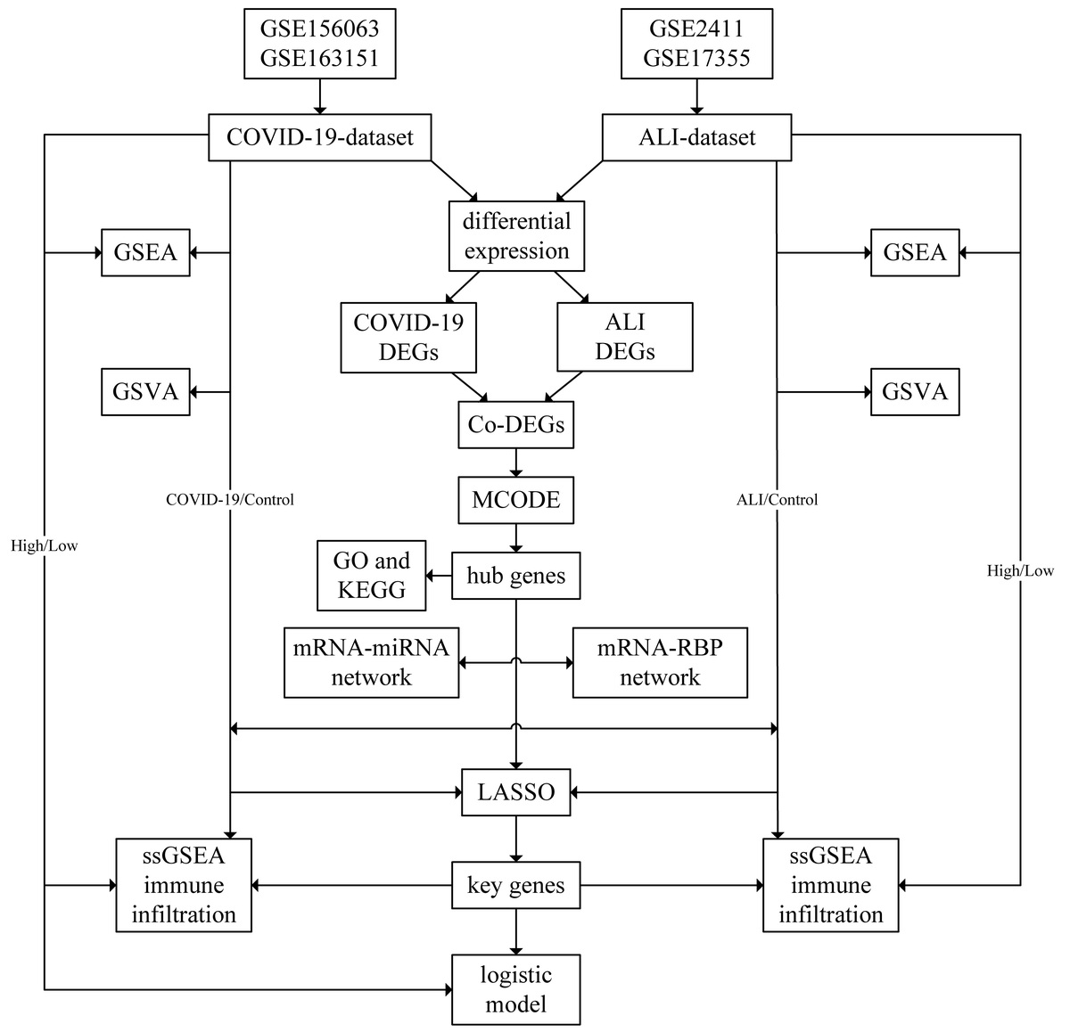

Identification of key overlapping genes between COVID-19 and acute lung injury to evaluate immune microenvironment and predictive efficiency
DOI: 10.5114/aoms/211889
Arch Med Sci 2026;22(2):1239-1244
Notes:
Introduction
Material and methods
Results
Conclusions

