Slide 1
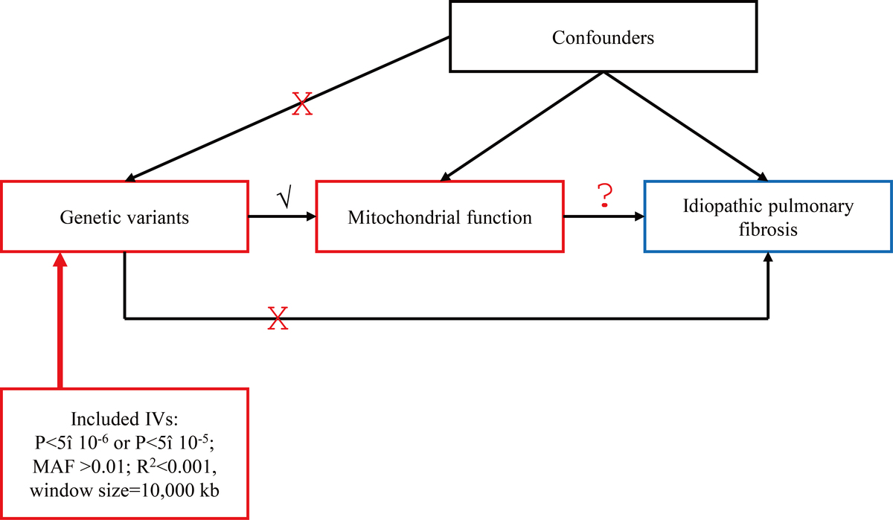

Exploring the causal association between mitochondrial dysfunction and idiopathic pulmonary fibrosis through two-sample Mendelian randomization
DOI: 10.5114/aoms/211890
Notes:
Introduction
Idiopathic pulmonary fibrosis (IPF) is a prevalent lung disease affecting mainly older adults, characterized by abnormal lung healing and an altered extracellular matrix. This study aims to explore the potential causal association between mitochondrial dysfunction and idiopathic pulmonary fibrosis.
Material and methods
This two-sample Mendelian randomization study analyzed GWAS data on mitochondrial dysfunction and IPF. The primary analysis employed the inverse variance weighted method, confirmed by the weighted median, weighted mode, and MR-Egger regression methods. Heterogeneity and pleiotropy were assessed using Cochran’s Q-test and MR-Egger, with robustness evaluated through leave-one-out analysis.
Results
The genetic predictions indicated a potential inverse causal association of Transmembrane protein 70 with IPF in the IVW (OR = 0.83, 95% CI: 0.70-0.99, P = 0.03), without evidence of heterogeneity, horizontal pleiotropy, or outliers. The MR-PRESSO analysis showed one outlier for NAD-dependent protein deacylase sirtuin-5 and one outlier for Serine-tRNA ligase. After removing the outliers, NAD-dependent protein deacylase sirtuin-5 showed a suggestive positive association with IPF (OR = 1.25, 95% CI: 1.09-1.43, P = 0.007), without evidence of heterogeneity, horizontal pleiotropy, or outliers.
Conclusions
This MR analysis provides genetic evidence for potential causal associations of Transmembrane protein 70 and NAD-dependent protein deacylase sirtuin-5 with IPF. These proteins may represent therapeutic targets and enhance understanding of mitochondrial dysfunction in IPF. Further validation is needed before clinical application.

