Slide 1
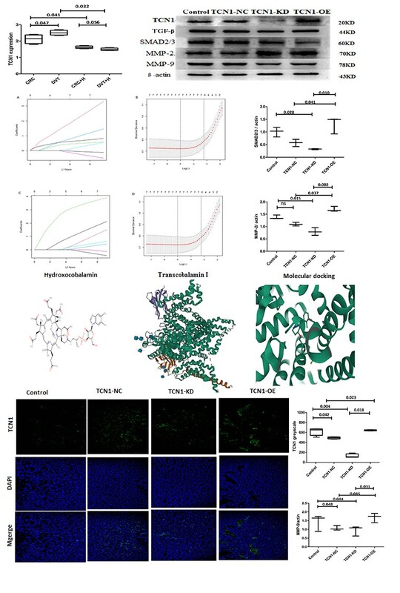

Transcobalamin I: a potential diagnostic biomarker and therapeutic target for deep venous thrombus in colorectal cancer
DOI: 10.5114/aoms/212634
Arch Med Sci 2025;21(6):2868-2871
Notes:
Introduction
Material and methods
Results
Conclusions

