Slide 1
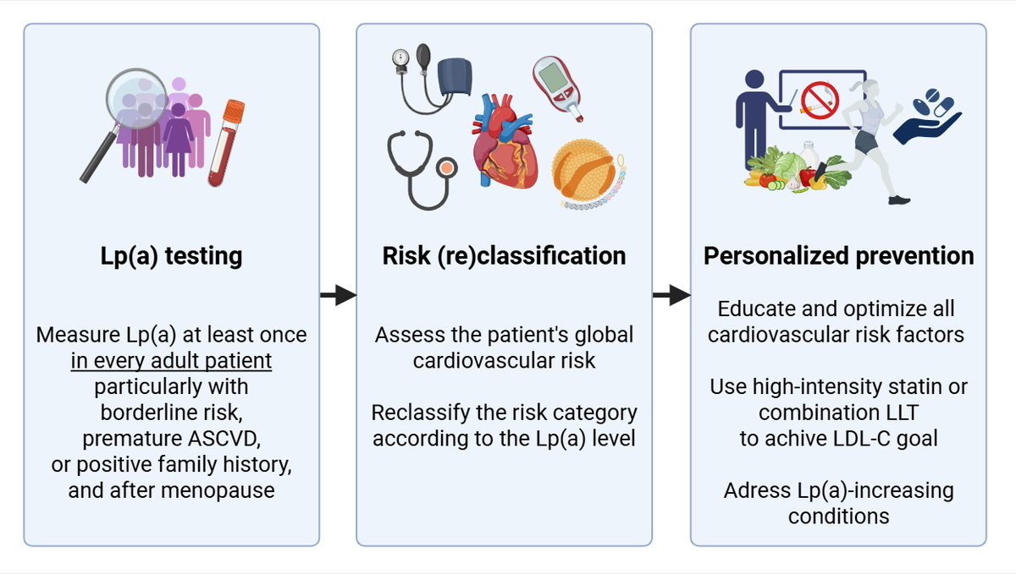

Incorporating lipoprotein(a) into patient care: the Polish landscape in light of national recommendations and the updated ESC/EAS guidelines
DOI: 10.5114/aoms/212635
Arch Med Sci 2025;21(6):2246-2257
Notes:
Atherosclerotic cardiovascular disease (ASCVD) is the leading cause of death in Poland. Lipoprotein(a) [Lp(a)] constitutes an independent, causal risk factor for ASCVD and aortic valve stenosis. Elevated Lp(a) is found in approximately 20% of the Polish population. Lp(a) measurements have been recommended in all adult patients to improve cardiovascular risk stratification. As the testing rate remains insufficient, there is a need to facilitate the incorporation of Lp(a) into routine patient care. This clinically oriented review outlines (i) up-to-date evidence on the role of Lp(a) in cardiovascular diseases, (ii) recent real-world data on the characteristics of Polish patients with elevated Lp(a), and (iii) strategies for Lp(a) testing and management in light of the current national recommendations and the latest 2025 Focused Update of the 2019 ESC/EAS Guidelines for the management of dyslipidemias.

