Slide 1
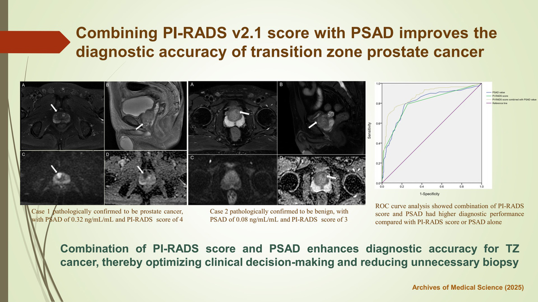

Combining the PI-RADS v2.1 score with PSAD improves the diagnostic accuracy of transition zone prostate cancer
DOI: 10.5114/aoms/213307
Arch Med Sci 2026;22(2):884-891
Notes:
Introduction
Transition zone (TZ) prostate cancer poses diagnostic challenges due to overlapping imaging features with benign prostatic hyperplasia (BPH). This study aimed to investigate whether Prostate Imaging Reporting and Data System (PI-RADS) v2.1 combined with prostate-specific antigen density (PSAD) can enhance diagnostic accuracy in distinguishing TZ cancer from BPH.
Material and methods
The retrospective study included 377 patients divided into two groups: the TZ cancer group (n = 139) and the BPH group (n = 238). Two radiologists independently reviewed prostate MR images of each patient and assigned a PI-RADS score for the TZ lesion. Clinical characteristics were compared between the two groups using the c2 test, t-test, or Mann-Whitney U-test. The diagnostic performance of PI-RADS scores, PSAD, and the combined parameters was determined by ROC curve analysis.
Results
Statistically significant differences were found in PSA, prostate volume, PSAD, and PI-RADS scores between the two groups (all p < 0.0001). No difference in age was observed between the two groups (p = 0.602). The area under the curve (AUC) for PI-RADS v2.1 alone was 0.802 (95% CI: 0.759–0.841) with a sensitivity of 79.14% and specificity of 74.37% at a cutoff of ³ 4. The AUC for PSAD alone was 0.808 (95% CI: 0.765–0.847) with a sensitivity of 79.14% and specificity of 77.31% at a cutoff of 0.22 ng/ml/ml. Combining PI-RADS and PSAD yielded an AUC of 0.873 (95% CI: 0.835–0.905), with a sensitivity of 79.26% and specificity of 86.55%.
Conclusions
The combination of PI-RADS v2.1 and PSAD enhances the diagnostic accuracy for TZ cancer, thereby reducing unnecessary invasive procedures.

