Slide 1
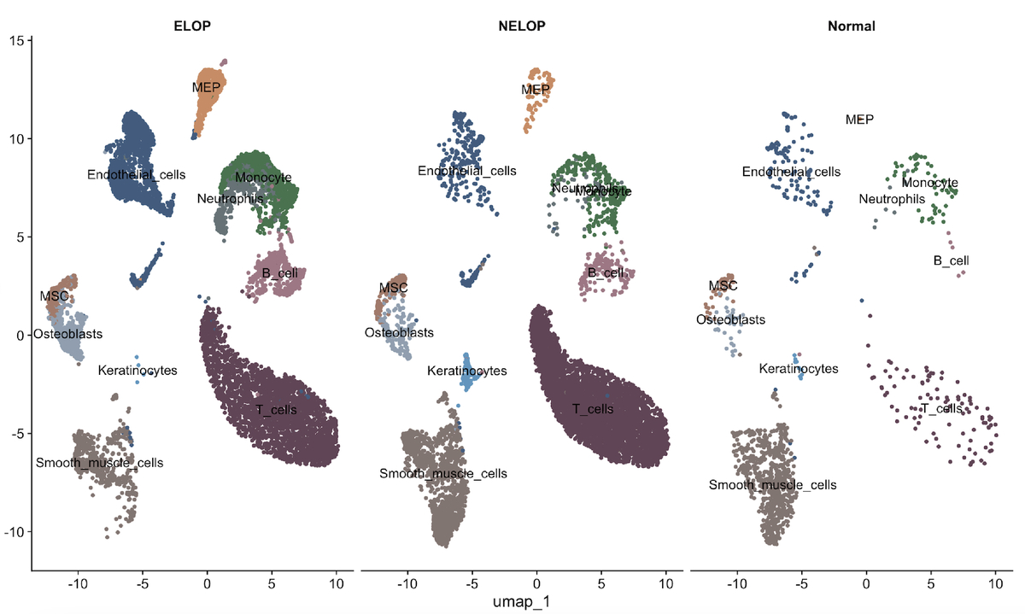

Integrated Mendelian randomization and single cell RNA sequencing identify cholesterol gene ABCA1 as a risk factor in oral lichen planus
DOI: 10.5114/aoms/213308
Notes:
Introduction
Material and methods
Results
Conclusions

