Slide 1
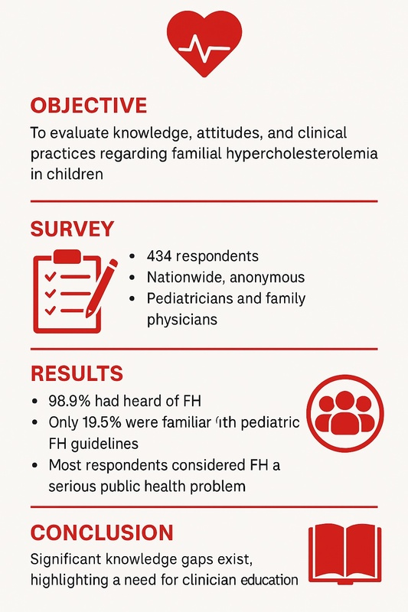

Awareness and management of pediatric familial hypercholesterolemia: a Polish physician survey
DOI: 10.5114/aoms/213683
Arch Med Sci 2025;21(5):2175-2178
Notes:
Introduction
Material and methods
Results
Conclusions

