Slide 1
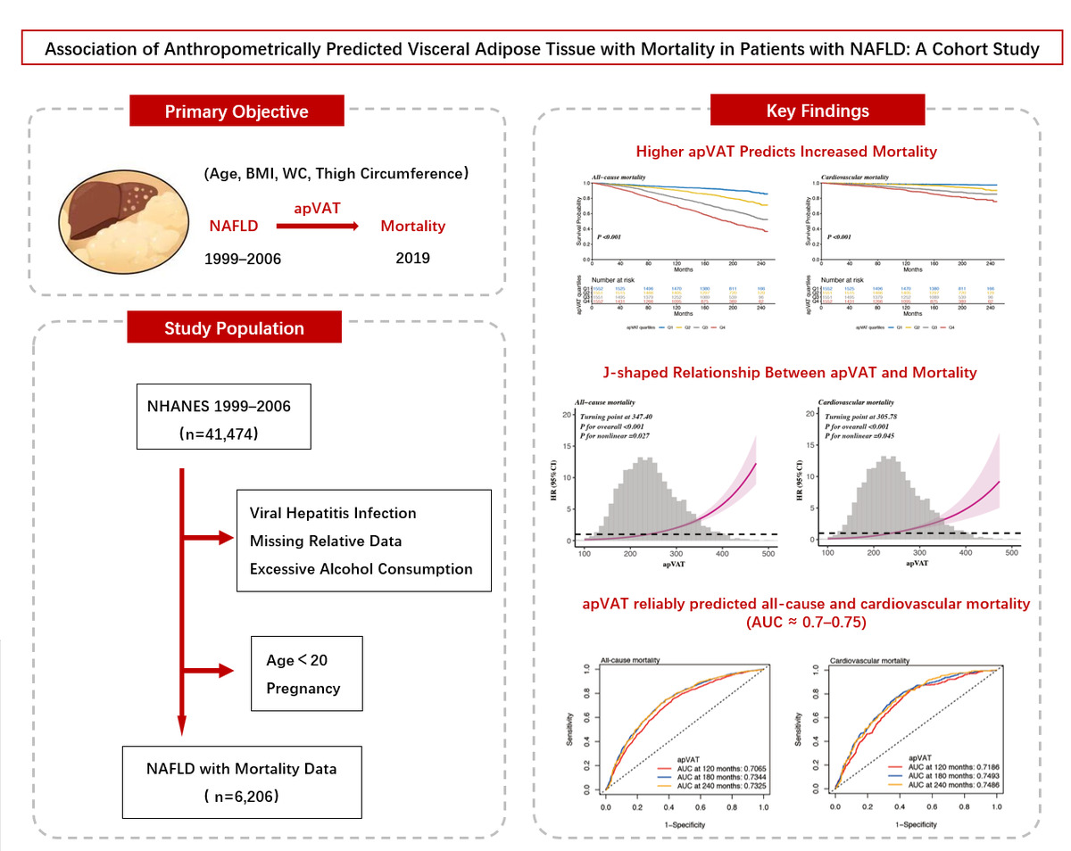

Association of anthropometrically predicted visceral adipose tissue with mortality in patients with non-alcoholic fatty liver disease: a cohort study
DOI: 10.5114/aoms/213684
Notes:
Introduction
The objective of this study was to evaluate the association between anthropometrically predicted visceral adipose tissue (apVAT) and mortality among individuals with non-alcoholic fatty liver disease (NAFLD).
Material and methods
This study analyzed 6206 NAFLD participants from the National Health and Nutrition Examination Survey. NAFLD was identified using the United States Fatty Liver Index (USFLI) or Fatty Liver Index (FLI). Baseline apVAT, an estimate of visceral fat derived from anthropometric parameters including age, body mass index (BMI), waist circumference (WC), and thigh circumference, was calculated using validated sex-specific equations. Mortality outcomes were determined by linking data to National Death Index (NDI) records up to December 31, 2019. Cox proportional hazards models and restricted cubic splines were used to examine associations, and time-dependent receiver operating characteristic (ROC) analyses were used to compare apVAT with other obesity indices including BMI, WC, thigh circumference, waist-to-height ratio (WHtR), relative fat mass (RFM), and weight-adjusted waist index (WWI).
Results
During a median follow-up period of 187 months, 1884 deaths from all causes and 517 from cardiovascular causes were observed. Multivariable-adjusted Cox analysis showed that the highest apVAT quartile had hazard ratios of 3.83 (3.01–4.87) for all-cause mortality and 3.47 (2.13–5.65) for cardiovascular mortality, compared to the lowest quartile. A nonlinear relationship between apVAT and mortality risk was identified. apVAT showed the highest predictive value for mortality risk compared with BMI, WC, thigh circumference, WHtR, RFM, and WWI.
Conclusions
Elevated apVAT levels are correlated with increased mortality risk in NAFLD, highlighting its potential as a prognostic marker.

