Slide 1
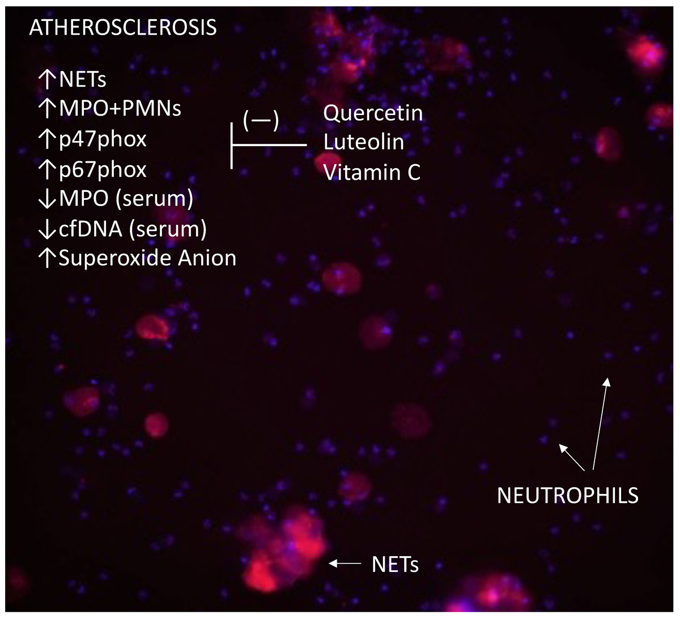

Beneficial effects of antioxidants on neutrophil extracellular trap formation in atherosclerosis
DOI: 10.5114/aoms/213753
Arch Med Sci 2026;22(3):1640-1652
Notes:
Introduction
Neutrophils have been implicated in the pathogenesis of atherosclerosis in multiple studies. This study aimed to determine the effects of flavonoids (quercetin and luteolin) and vitamin C on neutrophil extracellular trap (NET) formation and regulation of NET markers, including circulating cell-free DNA (cfDNA) and myeloperoxidase (MPO). Additionally, we assessed the expression of NADPH oxidase complex subunits and superoxide anion generation in neutrophils.
Material and methods
Whole blood samples were collected from patients with atherosclerosis. Neutrophils were stimulated with lipopolysaccharide (LPS), and the effects of flavonoids and vitamin C on NET release, NADPH oxidase subunit expression (p47phox, p67phox, Rac1), and superoxide production were evaluated.
Results
Atherosclerotic patients showed increased NETosis, with elevated NET release, MPO, and cfDNA levels. Expression of NADPH oxidase subunits p47phox and p67phox and superoxide anion generation were significantly higher compared to controls. LPS further enhanced these effects. Treatment with quercetin, luteolin, and vitamin C reduced NET formation, NADPH oxidase expression, and superoxide production in stimulated neutrophils.
Conclusions
Flavonoids and vitamin C modulate NET formation, likely by affecting NADPH oxidase activity and reactive oxygen species production, suggesting potential anti-inflammatory effects relevant to atherosclerosis. Further studies are warranted to evaluate the potential application of these compounds as adjunctive therapy in the treatment of atherosclerosis.

