Slide 1
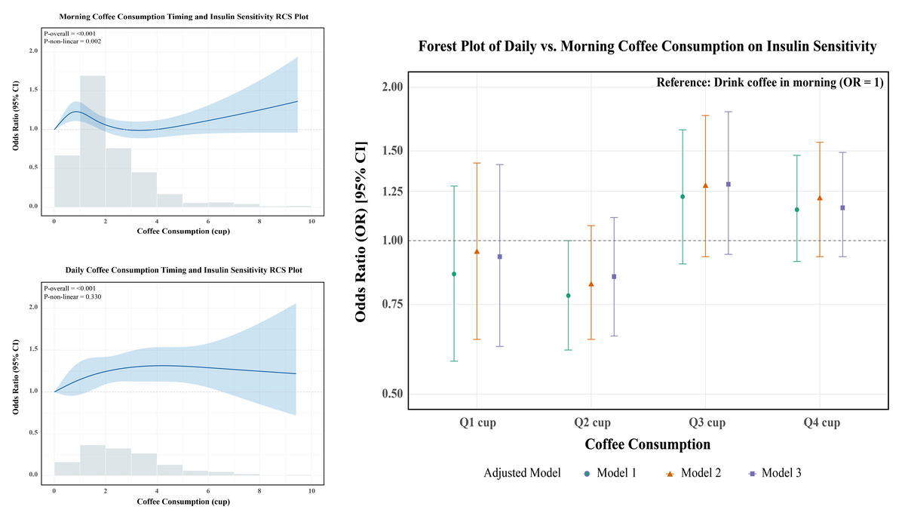

Timing and dose matter: a diurnal pattern of coffee consumption optimises improvement in insulin resistance
DOI: 10.5114/aoms/213786
Arch Med Sci 2025;21(6):2274-2286
Notes:
Introduction
Given insulin resistance’s (IR) critical role in metabolic pathophysiology, this study aims to identify optimal coffee consumption patterns by timing and dose to improve population health.
Material and methods
Multivariate logistic regression and restricted cubic splines assessed associations between coffee timing, dosage, and IR (measured by estimated glucose disposal rate) from NHANES data (1999–2018). Interaction and subgroup analyses explored variations across population segments.
Results
We analysed 21,138 participants, of whom 46.79% were non-consumers. Among consumers, 76% primarily drank coffee in the morning. Morning consumption at the lowest quartile (Q1) showed significant improvement in IR (odds ratio [OR] = 1.37, 95% confidence interval [CI]: 1.16–1.62), although this benefit diminished with higher consumption levels (p < 0.05). While the “all-day” pattern overall showed a non-significant trend toward improved insulin resistance (OR = 1.20, 95% CI: 0.83–1.73), higher consumption within this pattern (Q3: OR = 1.46, 95% CI: 1.13–1.89; Q4: OR = 1.34, 95% CI: 1.11–1.63) proved significantly more beneficial than lower intake. Comparative analysis revealed that morning consumption tended to be more advantageous for low-to-moderate intake (Q1-Q2), whereas all-day distribution showed potential benefits at higher consumption levels (Q3-Q4). The observed benefits were primarily associated with caffeinated coffee, attenuated by sugar addition, and varied across subgroups based on age, sex, and comorbidities.
Conclusions
Both morning and all-day coffee intake improve IR. For moderate consumption (1–2 cups/day), morning intake provides optimal improvement in insulin sensitivity. For higher intake (≥ 3 cups/day), distributed consumption is more effective. These findings support chrono-nutrition principles for optimising metabolic health through coffee consumption.

