Slide 1
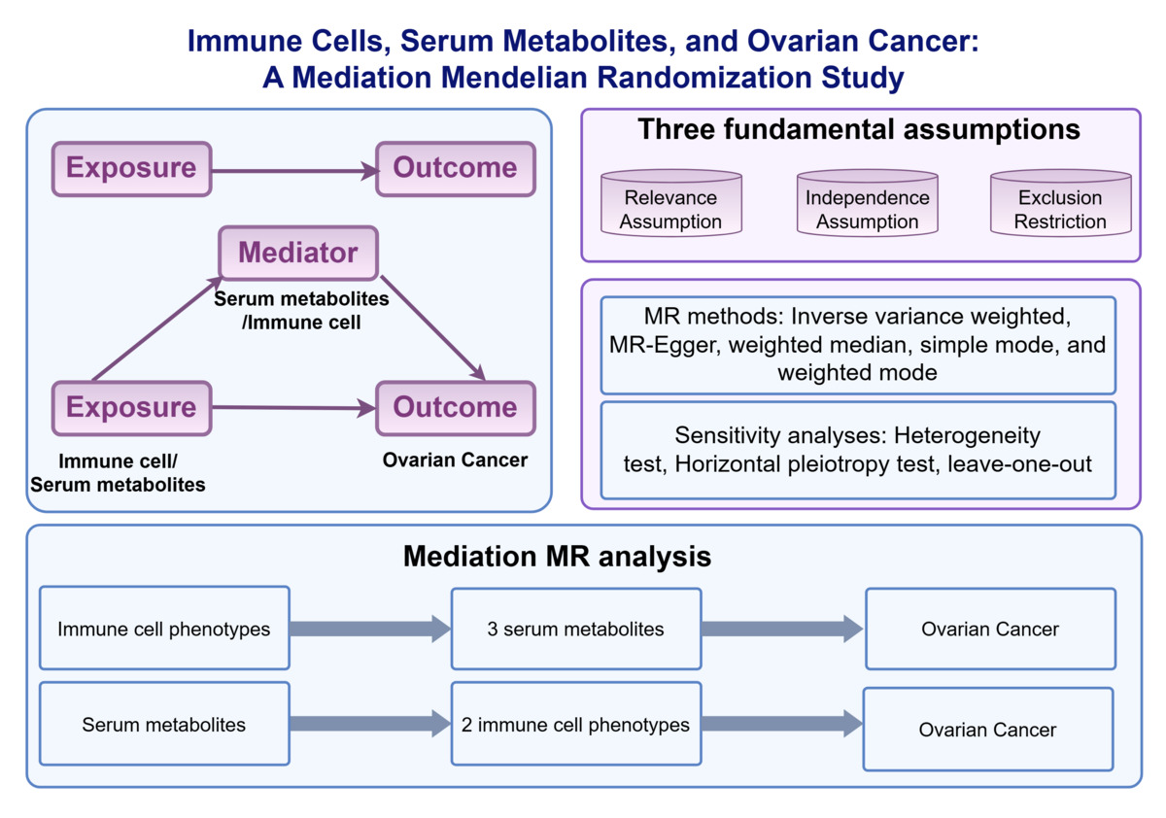

Immune Cells, Serum Metabolites, and Ovarian Cancer: A Mediation Mendelian Randomization Study
DOI: 10.5114/aoms/213840
Notes:
Introduction
Recent studies have highlighted the potential functions of immune cells and serum metabolites in the progression of ovarian cancer (OC). Therefore, this study executed Mendelian randomization (MR) methodology to seek out causal links among serum metabolites, immune cells, and OC.
Material and methods
This study wielded data from multiple sources to obtain genetic data related to immune cell phenotypes, serum metabolites, and OC. The causal effects were estimated using the inverse variance weighted, MR-Egger, weighted median, simple mode, and weighted mode to assess potential causal effects. Finally, mediation analysis was conducted to ascertain the potential mediating functions of immune cell phenotypes and serum metabolites in OC.
Results
36 causal links between immune cell phenotypes and OC were recognized. "Resting CD4 regulatory T cell %CD4 regulatory T cell" (OR = 0.977, p = 0.018) was protective, while "IgD- CD38dim B cell %B cell" (OR = 1.027, p = 0.021) was risk factor. Additionally, 89 causal relationships were identified between serum metabolites and OC. "Gluconate levels" (OR = 0.925, p = 0.047) was protective, while "fructose levels" (OR = 1.097, p = 0.019) was risk factor for OC. Mediation analysis identified 3 serum metabolites that mediated the influence of immune cell phenotypes on OC, alongside 2 immune cell phenotypes acting as mediators between serum metabolites and OC. Notably, sensitivity analysis validated the robustness of these findings.
Conclusions
This work supplies novel insights into the causal connections among immune cells, serum metabolites, and OC.

