Slide 1
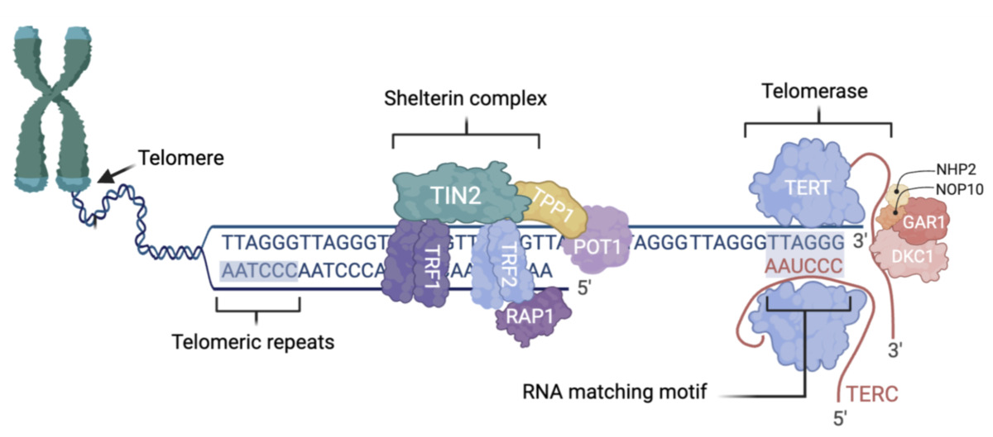

Insights into telomerase activity in bladder cancer pathology
DOI: 10.5114/aoms/213923
Notes:
Bladder cancer (BC) is among the top ten most commonly diagnosed cancers worldwide, with rising incidence and around 213,000 deaths annually. It exhibits a marked male predominance, largely attributable to risk factors such as tobacco use, occupational carcinogen exposure, and genetic predisposition. Bladder cancer is classified into non-muscle-invasive (NMIBC) and muscle-invasive (MIBC) forms, with the latter linked to worse prognosis. Despite current treatment modalities, including surgical resection with adjuvant chemotherapy or immunotherapy, disease management remains challenging due to high recurrence rates and limited therapeutic efficacy in advanced stages. Recent studies highlight telomerase activity, especially TERT promoter mutations present in about 70% of BC cases, as a key contributor to disease progression. These findings position telomerase as a promising biomarker for early detection, disease monitoring, and targeted therapy. This review summarizes recent advances in understanding telomerase regulation in BC and its potential clinical applications.

