Slide 1
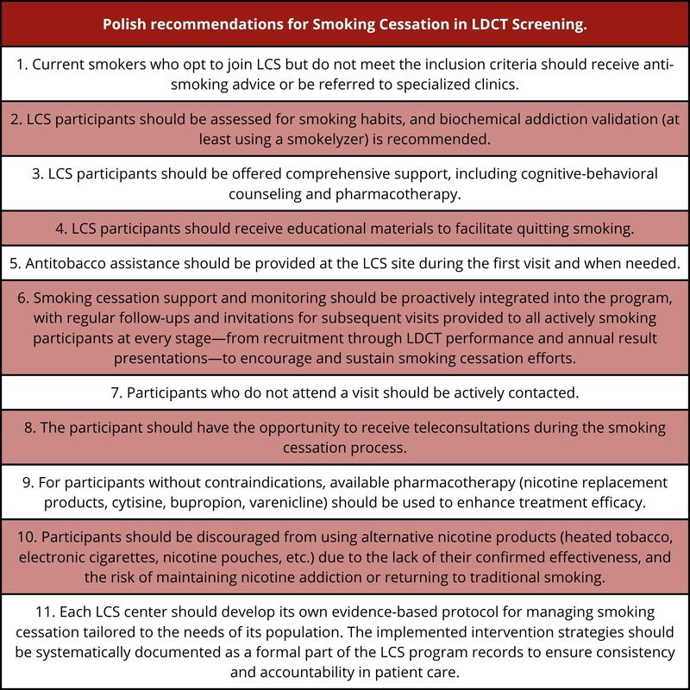

Polish consensus on smoking cessation intervention within lung cancer screening
DOI: 10.5114/aoms/214091
Arch Med Sci 2025;21(6):2219-2228
Notes:
Lung cancer, the leading cause of cancer-related deaths globally and in Poland, accounts for 25% of all cancer-related deaths, with smoking being its predominant cause. While primary prevention through smoking cessation is crucial, the effectiveness of lung cancer screening (LCS) with low-dose computed tomography in reducing mortality has gained international recognition. This expert consensus, developed through multidisciplinary collaboration, proposes a comprehensive framework for smoking cessation interventions within LCS. Key recommendations include providing participants with educational materials, cognitive-behavioral counseling, and pharmacotherapy. Proactive follow-up, biochemical addiction validation, and teleconsultations are essential to ensure long-term cessation. Besides, participants should be discouraged from using alternative nicotine products, such as heated tobacco or electronic cigarettes due to their limited efficacy, highly probable health risks and potential for nicotine addiction. By integrating evidence-based cessation methods, LCS programs can serve as a model for broader smoking cessation strategies in healthcare.

