Slide 1
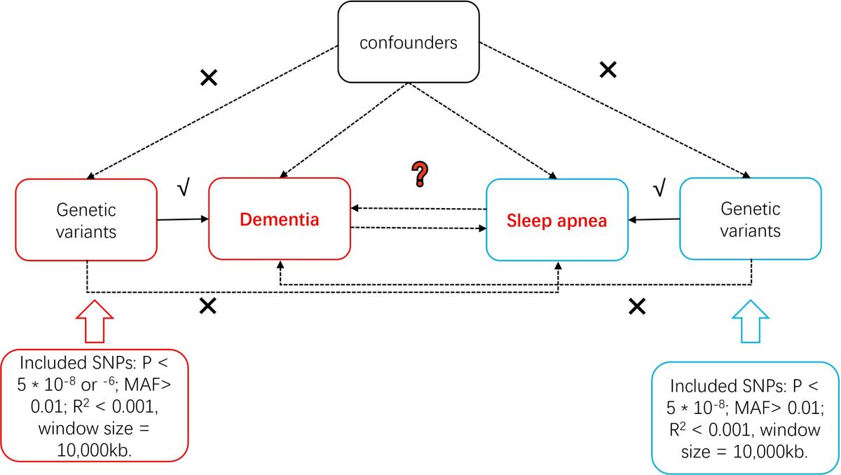

Causal associations between sleep apnea and dementia: a two-sample Mendelian randomization study
DOI: 10.5114/aoms/214094
Arch Med Sci 2026;22(2):822-833
Notes:
Introduction
Observational studies suggest an association between sleep apnea and dementia, but causality and directionality are unclear. This study investigated bidirectional causal relationships between sleep apnea and various dementia types using two-sample Mendelian randomization (MR).
Material and methods
This study used summary-level data from genome-wide association studies (GWAS). Sleep apnea (including obstructive sleep apnea (OSA) and generalized sleep apnea) exposure data were from a European ancestry study. Dementia (general, Alzheimer’s, vascular, etc.) outcome/exposure data were from the Finnish FinnGen consortium. The inverse variance weighted (IVW) method was used as the primary analysis, supplemented by multiple analyses (MR-Egger, weighted median, weighted mode). Robustness was assessed using several sensitivity analyses, including MR-PRESSO, Cochran’s Q test, and leave-one-out analysis.
Results
Forward analysis, after MR-PRESSO outlier correction, showed that OSA was associated with reduced unspecified dementia risk (IVW, OR = 0.830, 95% CI = 0.700–0.970). Reverse analysis, after outlier removal, indicated that general dementia was associated with reduced OSA risk (IVW, OR = 0.9399, 95% CI = 0.9187–0.9615) and generalized sleep apnea risk (IVW, OR = 0.9141, 95% CI = 0.8863–0.9427). Alzheimer’s dementia was also associated with reduced OSA and generalized sleep apnea risk. Sensitivity analyses did not reveal significant horizontal pleiotropy for the main findings, and heterogeneity was generally within acceptable limits.
Conclusions
This MR study revealed complex, bidirectional genetic associations between sleep apnea and dementia subtypes. These findings provide new genetic insights into the complex interplay between sleep apnea and dementia, highlighting subtype-specific associations.

