Slide 1
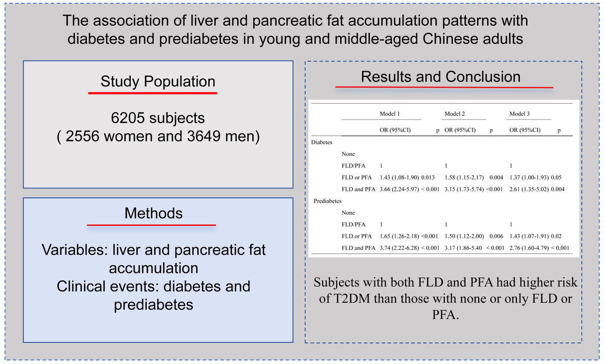

The association of liver and pancreatic fat accumulation patterns with diabetes and prediabetes in young and middle-aged Chinese adults
DOI: 10.5114/aoms/214286
Notes:
Introduction
The combined role of fatty liver disease (FLD) and pancreatic fat accumulation (PFA) in diabetes is unknown. In the present study, we aimed to evaluate the relationship between the phenotype of FLD and PFA and type 2 diabetes mellitus (T2DM) or prediabetes in young and middle-aged adults.
Material and methods
6205 adults aged 25–60 years who underwent computed tomography (CT) chest examinations were included in this study. Fatty liver disease was defined based on the ratio of liver CT attenuation and spleen CT attenuation (ratio < 0.8). PFA was defined based on the ratio of pancreatic CT attenuation and spleen CT attenuation (ratio < 0.9). The phenotype of FLD and PFA was divided into three groups: neither FLD nor PFA; either FLD or PFA; both FLD and PFA.
Results
There were 236 patients with T2DM and 242 subjects with prediabetes. 1861 subjects had FLD or PFA, and 190 subjects had both FLD and PFA. Subjects with both FLD and PFA or subjects with either FLD or PFA had higher risk of T2DM or prediabetes than those with neither FLD nor PFA (odds ratio (OR) = 2.61, 95% CI:1.35–5.02; OR = 1.37, 95% CI: 1.00–1.93; OR = 2.76, 95% CI: 1.60–4.790; OR = 1.43, 95% CI: 1.07–1.91). Subjects with both FLD and PFA also had a higher risk of prediabetes and prediabetes + diabetes than those with FLD or PFA alone (OR = 1.66, 95% CI: 1.00–2.88; OR = 1.64, 95% CI: 1.02–2.63).
Conclusions
Subjects with both FLD and PFA had higher risk of T2DM than those with neither condition or either FLD or PFA.

