Slide 1
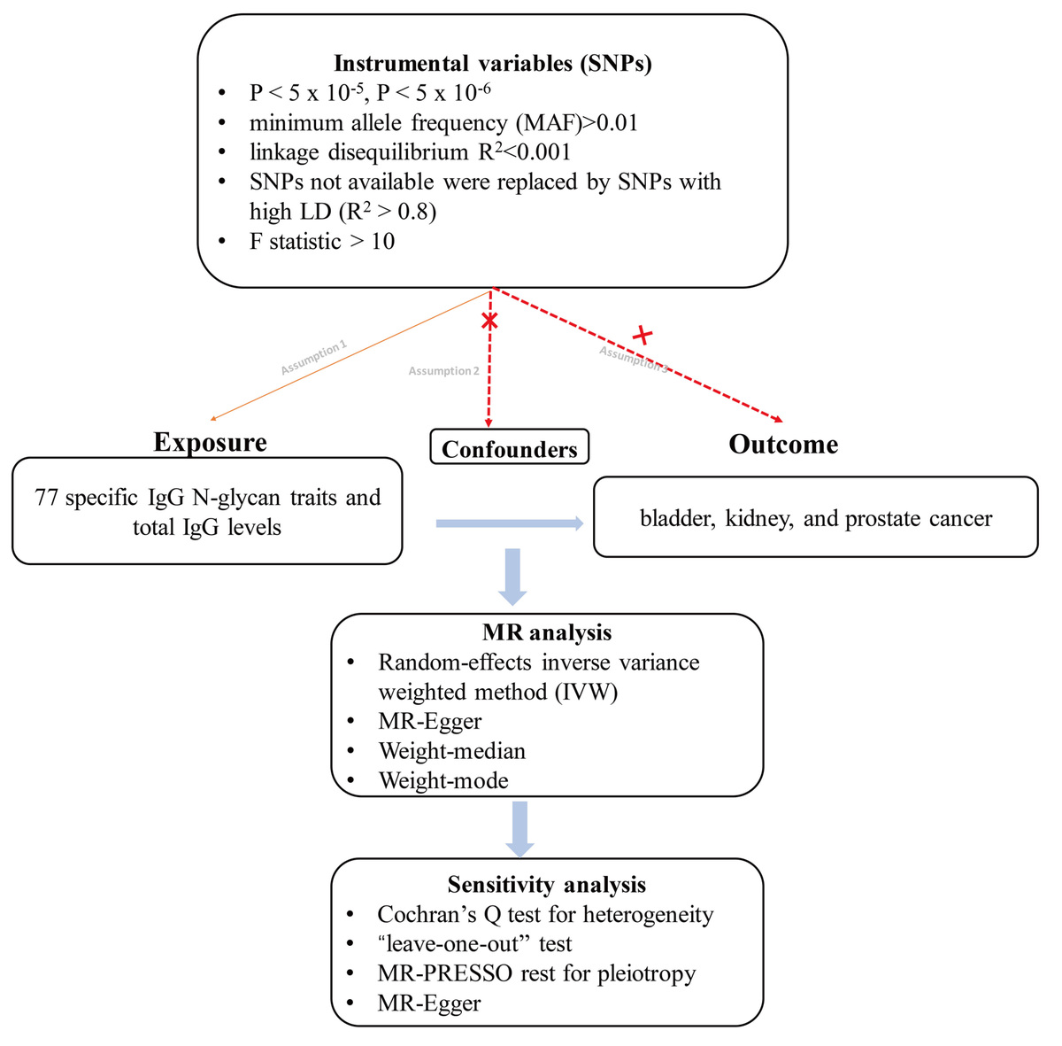

Exploring the potential causal role of IgG N-glycosylation in urological cancers: a two-sample Mendelian randomization study using European ancestry datasets
DOI: 10.5114/aoms/214288
Arch Med Sci 2026;22(3):1738-1747
Notes:
Introduction
Urological cancers pose a significant global health burden. Alterations in immunoglobulin G(IgG) N-glycosylation are implicated in cancer pathogenesis, but their causal role remains unclear. This study aimed to explore the potential causal associations between 77 specific IgG N-glycan traits (IGPs) and the risks of bladder, kidney, and prostate cancer.
Material and methods
We conducted a two-sample Mendelian randomization (MR) study using summary-level data. Genetic instruments for IGPs were obtained from a genome-wide association study (GWAS) of European descent. Outcome data were sourced from the FinnGen consortium. The inverse-variance weighted (IVW) method was the primary analysis, supplemented by multiple sensitivity analyses (MR-Egger, weighted median, MR-PRESSO, and MR-RAPS). The Steiger test was used to confirm causal direction.
Results
After false discovery rate (FDR) correction, one association remained statistically significant. Using the IVW method, genetically predicted higher levels of IGP23 were significantly associated with a decreased risk of bladder cancer (OR = 0.78, p = 4.7e-04, FDR = 0.037). Thirteen additional nominal associations (p < 0.05) were observed for urological cancers (e.g., IGP10 for prostate cancer; IGP52, IGP73 for kidney cancer), although these did not withstand multiple testing correction. Sensitivity analyses showed no evidence of directional pleiotropy.
Conclusions
Our study provides evidence supporting a potential causal association between the IgG N-glycan trait IGP23 and the risk of bladder cancer. Other nominal associations require further investigation. These findings highlight IGP23 as a candidate for future mechanistic and translational research in bladder cancer.

