Slide 1
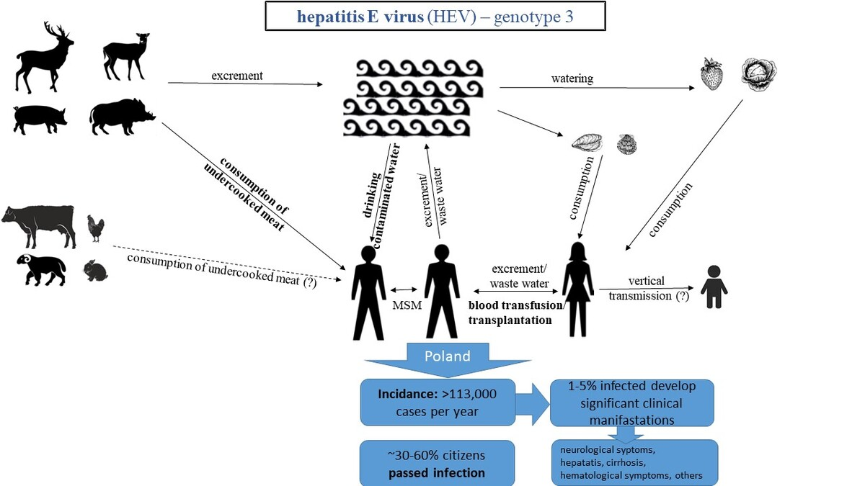

Hepatitis E virus (HEV) as an emerging challenge in Poland: a narrative review of epidemiological and clinical data
DOI: 10.5114/aoms/214289
Arch Med Sci 2026;22(3):1275-1291
Notes:
Manuscripts on hepatitis E virus (HEV) epidemiology in Poland indexed in PubMed were analyzed in the context of current clinical and biological knowledge and epidemiological data from other regions of Europe and worldwide. The analyzed data indicate a high frequency of IgG HEV in Poland compared to other European countries and parts of the world, on average exceeding 40%. In some regions, almost 60% of the population has evidence of prior infection. It has been estimated based on the frequency of acute phase markers that at least 113,000 residents may acquire HEV infection annually. These findings support the need to improve availability of HEV diagnostics, increase physicians’ awareness, and take into account HEV infection as an etiological factor of numerous diseases. Preventive measures, especially in high-risk groups, as well as further research on the clinical significance of HEV and on effective therapeutic management, should be considered.

