Slide 1
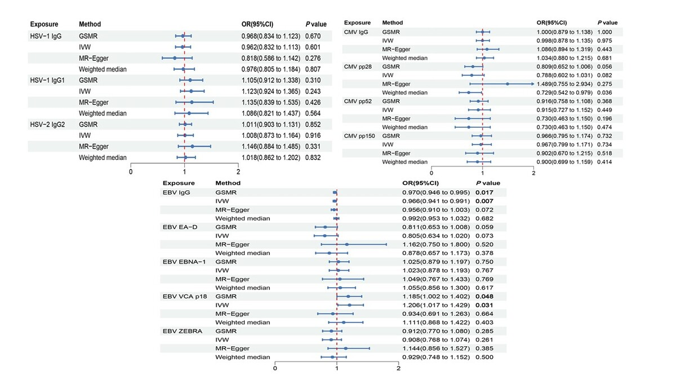

Epstein-Barr virus-related antibody traits and idiopathic pulmonary fibrosis: a bidirectional Mendelian randomization study
DOI: 10.5114/aoms/214291
Arch Med Sci 2026;22(3):1811-1821
Notes:
Introduction
Previous studies have suggested an association between herpesvirus infections and idiopathic pulmonary fibrosis (IPF), but the causal relationship remains largely unclear. We used bidirectional Mendelian randomization (MR) to investigate the associations between genetically predicted antibody responses to herpesviruses and IPF risk.
Material and methods
The data for different antibodies against herpes simplex virus (HSV), cytomegalovirus (CMV), and Epstein-Barr virus (EBV) were obtained from the IEU GWAS database (https://gwas.mrcieu.ac.uk/datasets/), and the data for IPF were obtained from the FinnGen GWAS database (https://r7.finngen.fi/). We selected eligible single nucleotide polymorphisms (SNPs) from summary-level data of GWAS as instrumental variables. The generalized summary data-based MR (GSMR) method was used as the main analysis method, complemented by inverse-variance weighted (IVW), MR-Egger, and weighted median analyses. Sensitivity analyses were conducted to check the robustness of the MR results, and reverse MR analyses were performed to assess potential reverse causation.
Results
Genetically predicted antibody responses to EBV viral capsid antigen (VCA) p18 were associated with IPF risk. However, GSMR and IVW results indicated that anti-EBV IgG levels were significantly negatively associated with IPF. Sensitivity analyses suggested limited influence of horizontal pleiotropy.
Conclusions
Genetically predicted EBV-related immune responses show heterogeneous associations with IPF risk. These findings suggest a potential role of EBV-related immune mechanisms in IPF, although causal interpretation should be made cautiously. Further studies are needed to clarify underlying biological mechanisms.

