Slide 1
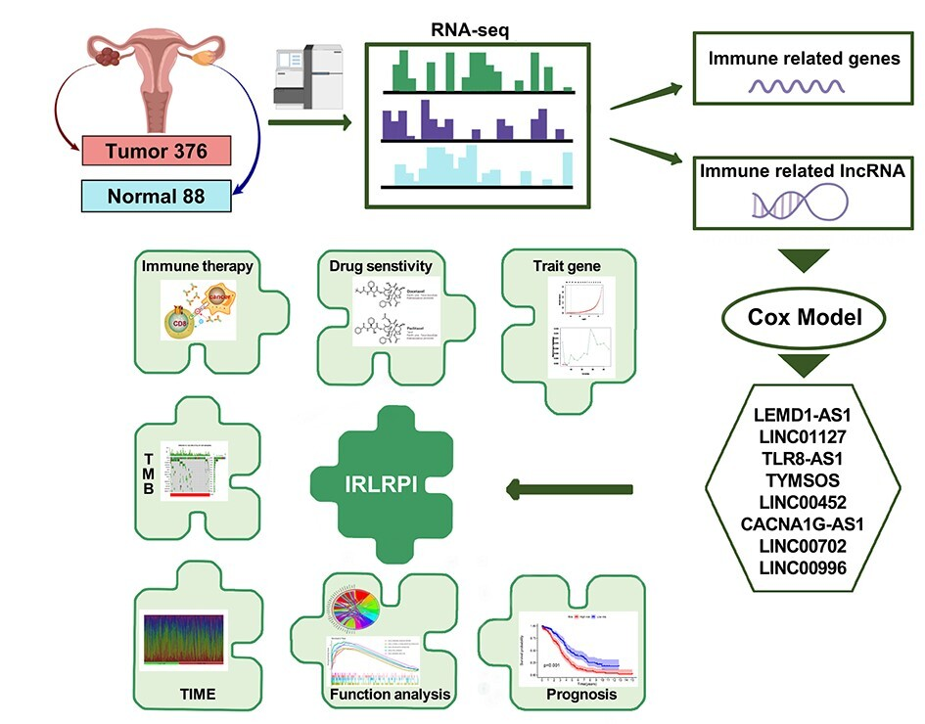

Prognostic index of immune-related lncRNAs for immunotherapy responsiveness and chemotherapy sensitivity in ovarian cancer patients
DOI: 10.5114/aoms/214432
Notes:
Introduction
Ovarian cancer (OV), ranking among the most lethal gynecologic malignancies, is characterized by elevated mortality rates primarily attributable to immature diagnostic tools and the insensitivity of chemotherapy. Despite the impressive success of immune checkpoint inhibitor (ICI) therapy in the treatment of several solid tumors, OV patients only partially benefit from immune checkpoint blockade. Therefore, a biomarker is necessary to predict the responsiveness of OV patients to immunotherapy. This study sought to identify an immune-associated lncRNA-based prognostic signature to predict immunotherapy efficacy and chemosensitivity in OV patients.
Material and methods
We used ovarian cancer transcriptional profiles of patients from TCGA and GTEx databases with immune-related signature genes to screen immune-related lncRNAs. Furthermore, we integrated the GEO database to evaluate an immune-related lncRNA prognostic score (IRLRPI), and then verified the model in all aspects to distinguish biomarkers of IRLRPI subtypes.
Results
Our findings demonstrated that patients with elevated IRLRPI scores had a poorer prognosis and tended to be more immunosuppressed; in terms of treatment, these patients may exhibit resistance to immunotherapy and be less sensitive to several chemotherapeutic agents. Finally, the biomarkers KIF26B and VSTM2L were found to distinguish IRLRPI type.
Conclusions
The IRLRPI model we developed can predict immunotherapy responsiveness and chemotherapy sensitivity in ovarian cancer patients and demonstrates potential for clinical application.

