Slide 1
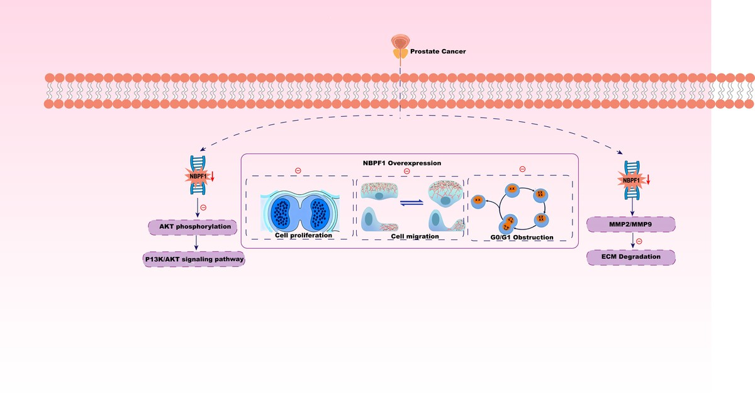

NBPF1 acts as a tumor suppressor in prostate cancer by regulating the PI3K/AKT pathway
DOI: 10.5114/aoms/214433
Arch Med Sci 2026;22(3):1748-1773
Notes:
Introduction
Prostate cancer (PCa) is a leading malignancy in men, yet the roles of many candidate regulators remain unclear. Neuroblastoma breakpoint family member 1 (NBPF1) has been implicated as a tumor suppressor in other cancers; however, its function and clinical relevance in PCa remain undefined.
Material and methods
NBPF1 expression was examined in tissue microarrays (TMAs) comprising 77 PCa tumors and 73 normal prostate tissues using immunohistochemistry, and its correlation with clinicopathological features and outcomes was assessed. NBPF1 gain- and loss-of-function models were established in PCa cell lines (LNCaP, DU145, PC3, 22RV1) and compared with RWPE-1 cells. Proliferation (CCK-8, EdU, colony formation), migration/invasion (wound healing, Transwell), and protein expression (qRT-PCR, Western blot) were assessed. In vivo oncogenic effects were evaluated using PC3 xenografts (n = 5 per group). RNA-seq of NBPF1-silenced PC3 cells, as well as KEGG analysis, was used to identify downstream pathways.
Results
NBPF1 was markedly downregulated in PCa compared with normal prostate, and low expression was associated with adverse features (e.g., higher Gleason grade) and poorer prognosis. NBPF1 overexpression suppressed proliferation, migration, and invasion, whereas NBPF1 knockdown had the opposite effects. In mice, NBPF1 loss accelerated tumor growth. Transcriptomic profiling implicated the PI3K/AKT signaling pathway as a key downstream pathway; concordantly, NBPF1 loss increased p-AKT and elevated MMP2/MMP9 expression, while NBPF1 overexpression reduced pathway activation and protease expression.
Conclusions
NBPF1 functions as a tumor suppressor in PCa, inhibiting progression at least partly through modulation of the PI3K/AKT pathway. NBPF1 may serve as a prognostic biomarker and a potential therapeutic target in prostate cancer.

