Slide 1
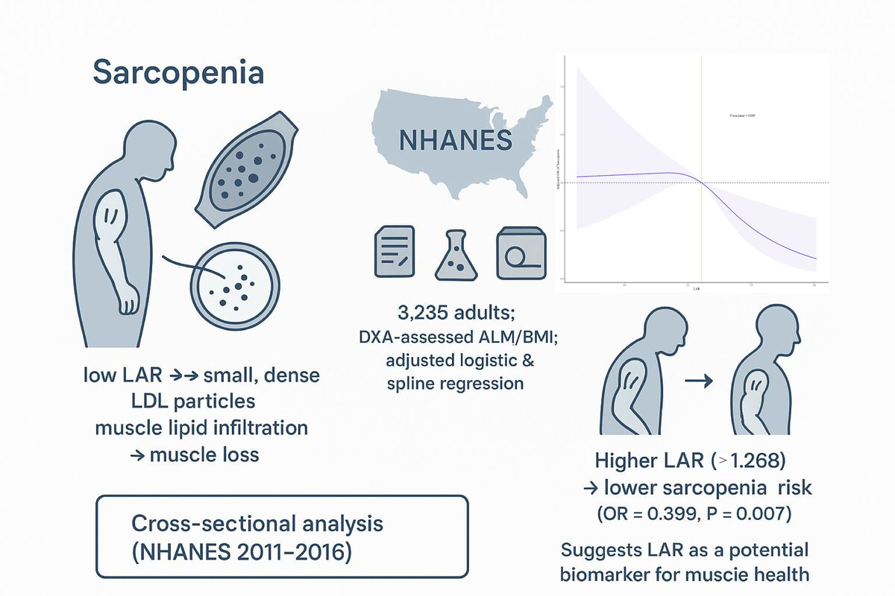

The association of low-density lipoprotein cholesterol with apolipoprotein B ratio and sarcopenia: a cross-sectional study
DOI: 10.5114/aoms/214480
Arch Med Sci 2026;22(3):1326-1334
Notes:
Introduction
Sarcopenia is increasingly linked to metabolic dysregulation, including dyslipidemia. The low-density lipoprotein cholesterol with apolipoprotein B (LDL-C/ApoB) ratio (LAR), reflecting cholesterol content per atherogenic lipoprotein particle, may serve as a novel biomarker for sarcopenia risk. This study aimed to investigate the association between LAR and sarcopenia using data from the National Health and Nutrition Examination Survey (NHANES).
Material and methods
Data from NHANES cycles 2011–2016 were analyzed between July 2024 and February 2025. Sarcopenia was defined using dual-energy X-ray absorptiometry (DXA)-derived appendicular lean mass (ALM) standardized to body mass index (BMI). Multivariable logistic regression, restricted cubic spline (RCS) regression analysis, subgroup analysis, and interaction tests were applied to evaluate the relationship between LAR and sarcopenia, adjusting for covariates.
Results
A negative correlation between LAR and sarcopenia was observed in 3,235 participants included in the study (OR = 0.399, 95% CI: 0.224–0.712, p = 0.007), which was further confirmed to be non-linear via RCS regression analysis (pnon-linear = 0.037), with one significant inflection point identified, and participants with LAR ≥ 1.268 demonstrated a significantly reduced risk of sarcopenia. Subgroup analyses and interaction tests indicated that the association between LAR and sarcopenia remained consistent across different subgroups and was not modified by other covariates.
Conclusions
Elevated LAR is significantly associated with lower sarcopenia risk, suggesting its potential role as a biomarker for muscle health. Further studies are needed to elucidate underlying mechanisms and validate these findings prospectively.

